Slide 1
Family Violence Multi Agency Risk Assessment and Risk Management Framework (MARAM)
Alignment briefing for executives of Framework organisations

Slide 2
How to use this slide pack
This slide pack contains pre-prepared slides on MARAM, with speaking notes, for your use.
The slides are intended to assist in explaining the impact of the MARAM reform on your organisation. They’re mainly for executives and managers who will oversee the necessary changes, but they can also be adapted for wider staff messaging.
Feel free to tailor the slides as best meets the needs of your organisation, while retaining the core MARAM content.
Notes:
MARAM overview
MARAM has been redeveloped to address the issues and gaps identified by the Royal Commission into Family Violence, the Coronial Inquest into the death of Luke Geoffrey Batty and the 2016 Monash Review of the CRAF.
The MARAM Framework sets requirements including determining responsibilities for screening, identification, risk assessment and management, information sharing and referral. The MARAM Framework recognises a wider range of risk indicators for children, older people and diverse communities, across identities, family and relationship types and will keep perpetrators in view and hold them accountable for their actions and behaviours.
The aim of the Framework is to increase the safety and wellbeing of Victorians by ensuring all relevant services are effectively identifying, assessing and managing family violence risk.
To achieve this, the Framework has been established in law under a new Part 11 of the Family Violence Protection Act 2008. This requires organisations that are prescribed through regulations, as well as organisations providing funded services relevant to family violence risk assessment and management, to align their policies, procedures, practice guidance and tools with the MARAM Framework.
MARAM commenced on 27 September 2018.

Slide 3
WHAT IS MARAM?

Slide 4
What is MARAM?
Recommendation 1 of the Royal Commission into Family Violence was for a renewed and updated comprehensive family violence framework that sets minimum standards and roles and responsibilities for screening, risk assessment, risk management, information sharing and referral throughout Victorian agencies.
Recommendation 2 was for the new framework to be prescribed in legislation so that framework organisations are required to align their risk assessment policies, procedures, practices and tools.
Notes:
MARAM overview
MARAM has been redeveloped to address the issues and gaps identified by the Royal Commission into Family Violence, several coronial inquests and inquiries including the Coronial Inquest into the death of Luke Geoffrey Batty and the 2016 Monash Review of the CRAF.
The MARAM Framework sets requirements including determining responsibilities for screening, identification, risk assessment and management, information sharing and referral. The MARAM Framework recognises a wider range of risk indicators for children, older people and diverse communities, across identities, family and relationship types and will keep perpetrators in view and hold them accountable for their actions and behaviours.
The aim of the Framework is to increase the safety and wellbeing of Victorians by ensuring all relevant services are effectively identifying, assessing and managing family violence risk.
To achieve this, the Framework has been established in law under a new Part 11 of the Family Violence Protection Act 2008. This requires organisations that are prescribed through regulations, as well as organisations providing funded services relevant to family violence risk assessment and management, to align their policies, procedures, practice guidance and tools to the MARAM Framework.
MARAM commenced with the first phase of prescribed workforces on 27 September 2018 on 27 September 2018.

Slide 5
What is MARAM?
The Multi-Agency Risk Assessment Management Framework – MARAM – is the response to these two recommendations. It is embedded in law and policy and establishes the system architecture and accountability mechanisms required for a system-wide approach to, and shared responsibility for, assessing and managing family violence risk.
Notes:
MARAM overview
MARAM has been redeveloped to address the issues and gaps identified by the Royal Commission into Family Violence, several coronial inquests and inquiries including the Coronial Inquest into the death of Luke Geoffrey Batty and the 2016 Monash Review of the CRAF.
The MARAM Framework sets requirements including determining responsibilities for screening, identification, risk assessment and management, information sharing and referral. The MARAM Framework recognises a wider range of risk indicators for children, older people and diverse communities, across identities, family and relationship types and will keep perpetrators in view and hold them accountable for their actions and behaviours.
The aim of the Framework is to increase the safety and wellbeing of Victorians by ensuring all relevant services are effectively identifying, assessing and managing family violence risk.
To achieve this, the Framework has been established in law under a new Part 11 of the Family Violence Protection Act 2008. This requires organisations that are prescribed through regulations, as well as organisations providing funded services relevant to family violence risk assessment and management, to align their policies, procedures, practice guidance and tools to the MARAM Framework.
MARAM commenced with the first phase of prescribed workforces on 27 September 2018 on 27 September 2018.

Slide 6
Benefits of aligning with MARAM for our organisation
Victim survivors, children and families already use our services – aligning with MARAM will help us keep them safe and support them to recover and thrive.
Our workforce already deals with family violence in our interactions – aligning with MARAM will provide staff with increased capability and confidence to identify, assess and respond.
Consistent and collaborative practice in our workforce, and across other framework organisations, will help ensure a more seamless response (a benefit to the workforce and service users).
Notes:
[Note: this slide should be adapted to make clear the positive benefits to a prescribed organisation in aligning with MARAM. The slide contains examples that may or may not be relevant to your organisation – there may be others not included above].

Slide 7
Benefits of aligning with MARAM for our organisation
Identifiable paths for secondary consultations and referrals will increase access to support for the workforce and service users.
Early identification can prevent escalation of violence.
Our workforce can feel supported for their own wellbeing (family violence affects our employees too).
Notes:
[Note: this slide should be adapted to make clear the positive benefits to a prescribed organisation in aligning with MARAM. The slide contains examples that may or may not be relevant to your organisation – there may be others not included above].

Slide 8

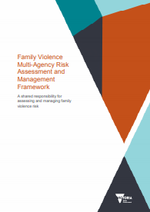
The Family Violence Multi-Agency Risk Assessment and Management Framework (MARAM)
The MARAM Framework contains 10 principles that guide and inform the ethical engagement of professionals and organisations with service users.
The principles support four pillars of practice that are set at organisational level, and which contain framework requirements for organisations to align with.
Alignment can be demonstrated by organisations incorporating relevant information from the four pillars into policies, procedures, practice guidance and tools.
Notes:
[Note: the next 3 slides look into the concepts of the MARAM Framework in a little more detail. This provides useful foundational knowledge. Discretion may be used on the audience for these slides].

Slide 9
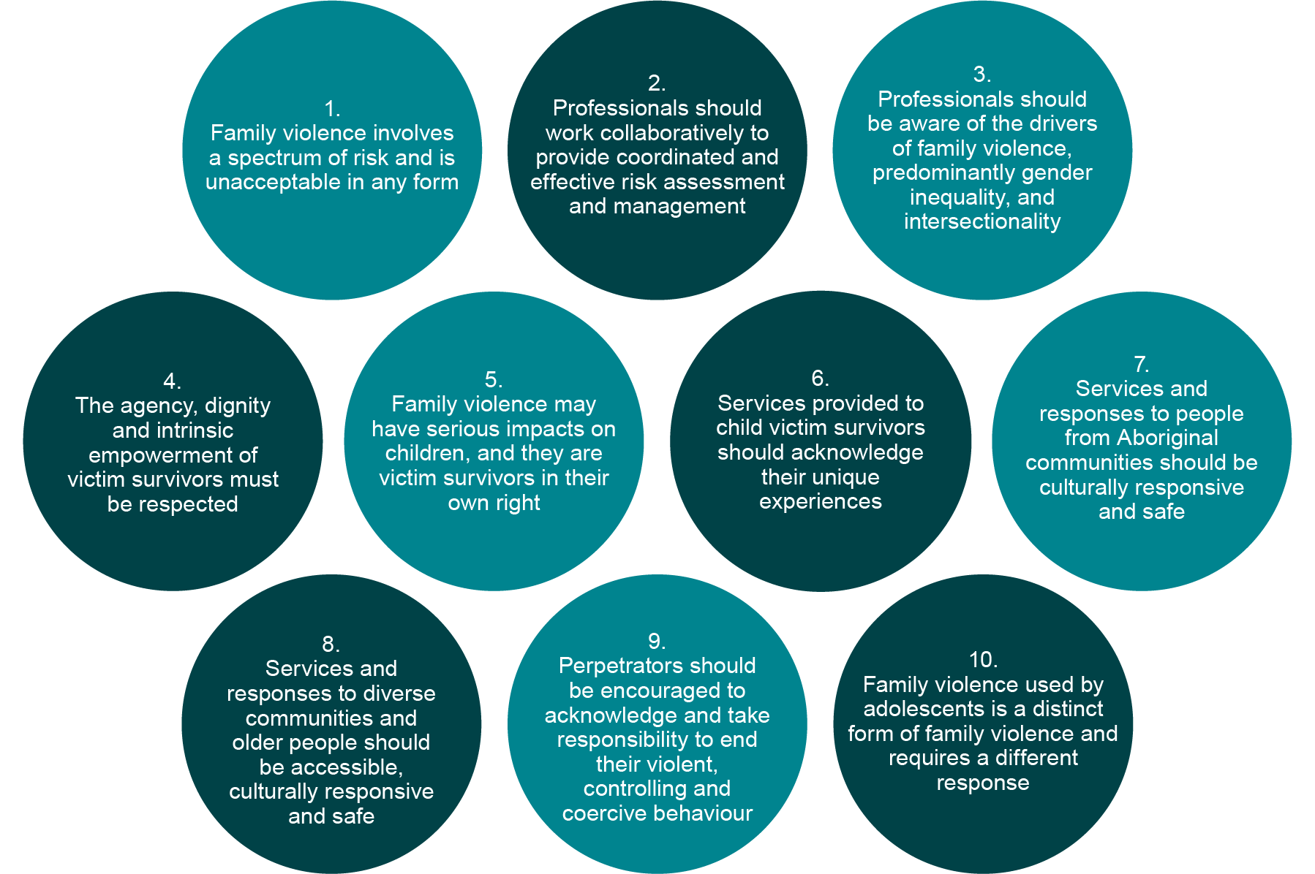
10 Principles of MARAM
Notes:
The 10 principles of MARAM are present throughout the MARAM Framework content. All implementation activities must take the 10 principles into account.

Slide 10
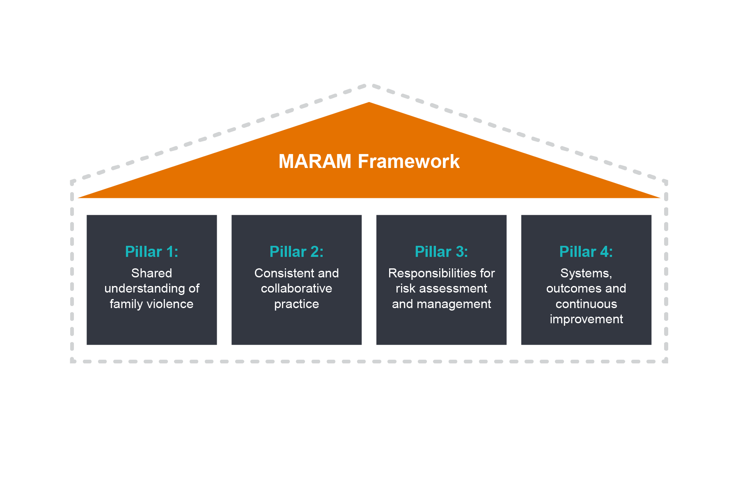
Pillars of the MARAM Framework
Pillars of the MARAM Framework
Notes:
The MARAM Framework is built around four pillars to establish a system-wide approach and shared responsibility for family violence risk assessment and management.
Pillar 1: Shared understanding of family violence
The definition and dynamics of family violence being centred on a pattern of coercion and control
The gendered nature of family violence
Impact of family violence including trauma effects
The importance of recognising children and young people as victim survivors in their own right
A clear emphasis and understanding that people may experience particular risks, forms of family violence and barriers to accessing support
Evidence-based indicators of risk
The concept that family violence used by adolescents is a distinct form of family violence and requires a different response to family violence by adults
Pillar 2: Consistent and collaborative practice
Seriousness of risk
Risk assessment approaches and tools, including for children as victim survivors
Perpetrator behaviour assessment
Risk management practice (including the importance of sharing relevant information)
Pillar 3: Responsibilities for risk assessment and management
There are 10 responsibilities for safe, sensitive engagement, identification and screening, assessment and management (including comprehensive practice), and coordinated collaborative practice and ongoing assessment.
Responsibility 6 is to contribute to information sharing with other services (as authorised by legislation)
Pillar 4: promote continuous improvement
Focus on improving the evidence about indicators of risk and intervention practices

Slide 11
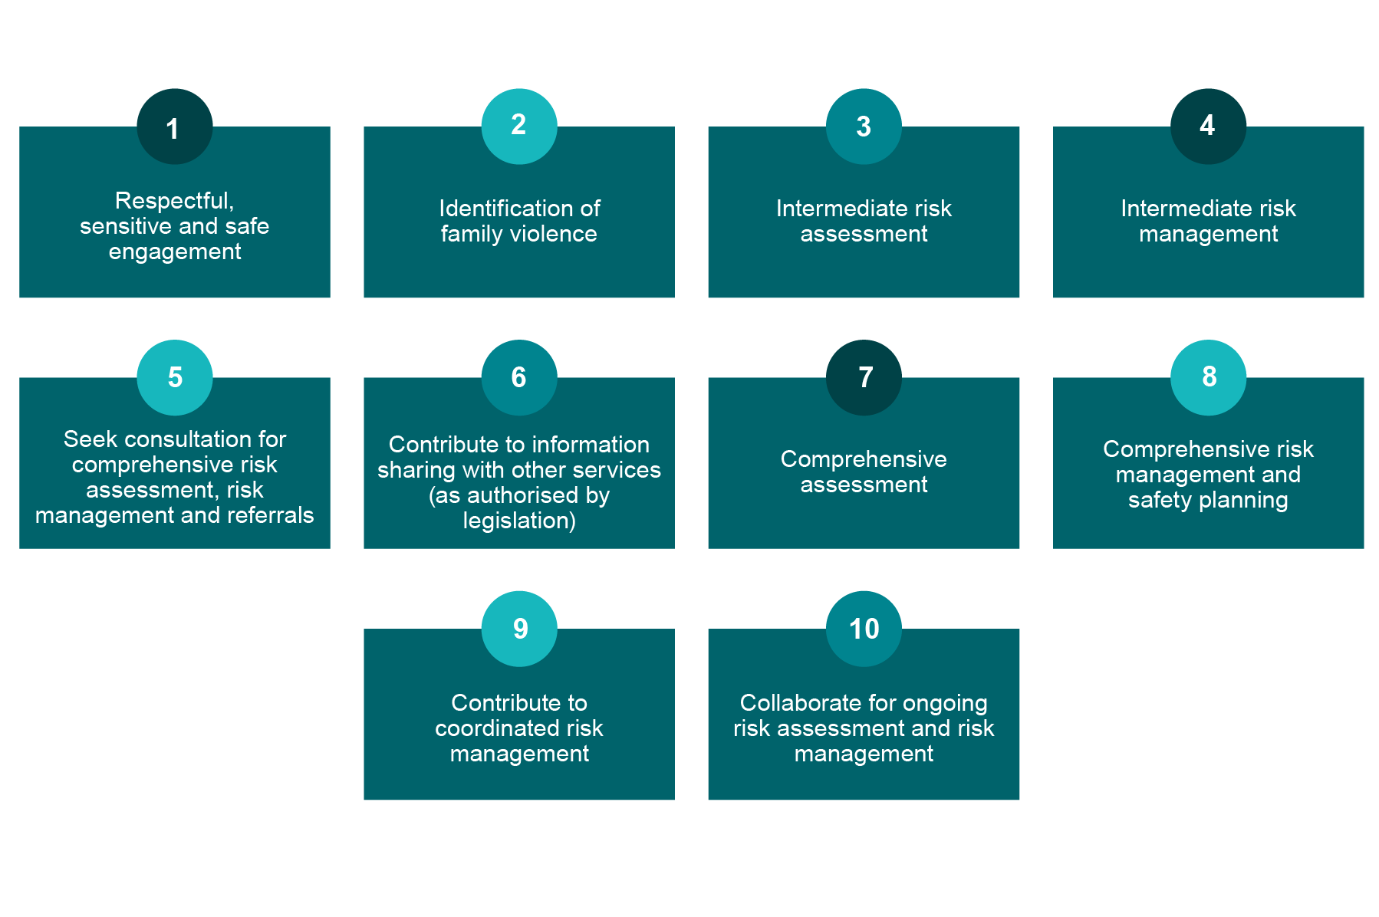
10 responsibilities
– within Pillar 3 of MARAM
Notes:
Responsibility 1: Organisational responsibility to create a respectful, sensitive and safe environment for people who may be experiencing family violence. Also outlines the importance of using a person-centred and trauma-informed approach, and recognising and addressing the challenges in service access for Aboriginal people and people from diverse communities. This applies to ALL organisations.
Responsibility 2: Identifying signs of trauma that may indicate family violence occurring, and undertaking screening. This applies to ALL organisations.
Responsibility 3: Undertaking intermediate risk assessment to assess the level or ‘seriousness’ of family violence risk for an adult or a child. This is for organisations with professionals whose role is linked to but not directly focused on family violence. This applies to SOME organisations [Note: indicate whether it applies to your organisation]
Responsibility 4: Undertaking safety planning and risk management to respond to the presentation and level of family violence risk. This takes place after risk assessment. This applies to SOME organisations [Note: indicate whether it applies to your organisation]
Responsibility 5: Seeking secondary consultations and undertaking referrals for further risk assessment and risk management. This applies to ALL organisations.
Responsibility 6: Sharing and responding to requests for information related to family violence risk, to further risk assessment and risk management. This applies to ALL organisations.
Responsibility 7: Comprehensive risk assessment of family violence including needs and protective factors. This applies to SPECIALIST FAMILY VIOLENCE PRACTITIONERS only. [Note: indicate whether it applies to your organisation]
Responsibility 8: Comprehensive risk management. This applies to SPECIALIST FAMILY VIOLENCE PRACTITIONERS only. [Note: indicate whether it applies to your organisation]
Responsibility 9: Working with other organisations to manage risk for victim survivors on a coordinated basis. This applies to ALL organisations.
Responsibility 10: Multi-agency collaboration for ongoing risk assessment and management. Within the organisation creating a practice that meets the aims of MARAM and includes operating procedures to enable collaborative practice. This applies to ALL organisations.

Slide 12
WHAT ARE THE INFORMATION SHARING SCHEMES?

Slide 13
Information sharing is a key enabler of MARAM
Information sharing authorises Information Sharing Entities (ISEs) to share risk relevant information with other services and individuals.
The Family Violence Information Sharing Scheme (FVIS Scheme) prescribes organisations as ISEs. This scheme is built on existing legislation for sharing of information (such as Data Protection Act 2014 and Child Youth and Families Act 2005). The Child Information Sharing Scheme (CIS Scheme) enables prescribed entities to share information to promote the wellbeing of safety of a child.
As an ISE we need to have processes in place to meet the legislative requirements for information sharing under the FVIS Scheme.

Slide 14
Information sharing is a key enabler of MARAM
Implementation of information sharing under the FVIS Scheme is different to MARAM, as it is not subject to a maturity model process. Once prescribed, we have to be in a position to make and respond to information sharing requests, and to maintain records and privacy.
Information sharing under any scheme (i.e. not just the FVIS Scheme but Child Information sharing scheme and other legislative permissions should be used applying the MARAM Framework.

Slide 15
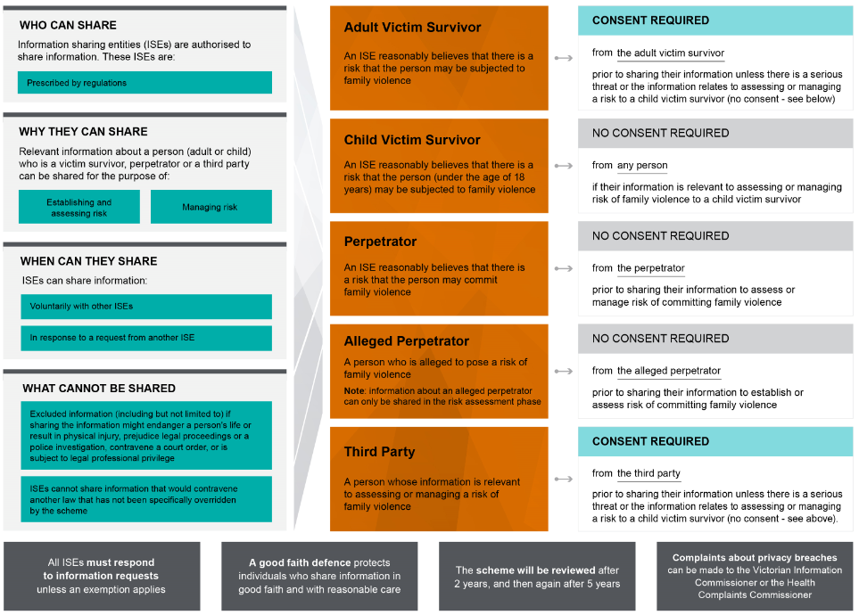
Family Violence Information Sharing Scheme – Overview
Notes:
Overview of the FVIS Scheme
The Royal Commission into Family Violence acknowledged that organisations that work with victims and perpetrators of family violence collect a wide variety of information in order to keep victims safe and hold perpetrators to account.
The Commission also identified barriers that prevent information from being shared as effectively as it could be and found that the failure to share crucial information with frontline workers can have catastrophic consequences.
In response to the Commission’s findings, a family violence information sharing scheme has been created by the new Part 5A of the Family Violence Protection Act 2008.
The scheme began on 26 February 2018, and it authorises a select group of prescribed information sharing entities (ISEs) to share information between themselves for family violence risk assessment and risk management.
The scheme does not interfere with existing legislation that allows information to be shared, such as privacy or child protection legislation.
Changes have also been made to Victorian privacy legislation that information can be shared in order to lessen or prevent a serious threat to the life, health, safety or welfare of a person.
The key elements of the scheme are:
If you can already share under other laws – then continue to do so
Requests must be complied with unless exemptions apply
Consent is not required from anyone when victim is a child; where there is no children, you must have adult victim or third party consent, unless there is serious risk to a person’s safety
Information Sharing Entities can share information without perpetrator consent

Slide 16
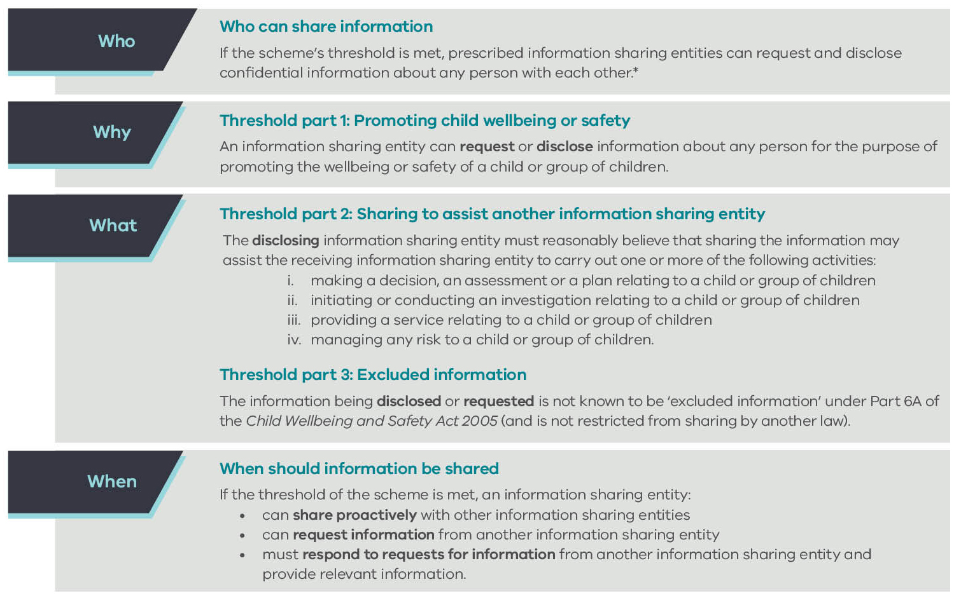
Child Information Sharing Scheme – Overview
Notes:
Overview of the CIS Scheme
The Child Information Sharing is also a new scheme. It responds to more than a decade of reviews and enquiries recommending reform to the way information is shared about children including:
McClellan Royal Commission into Institutional Responses to Child Sexual Abuse
The Commission for Children and Young People’s annual reports
Royal Commission into Family Violence
Victorian Auditor-General Office reports into vulnerable children and families
Multiple coroners inquests and reports
Cummins Inquiry on protecting Victoria’s vulnerable children
These inquiries have all recommended streamlining Victoria’s information sharing arrangements to improve outcomes for children by promoting shared responsibility for their wellbeing and safety and increasing collaboration across the service systems.
They also identified the need to modify a risk-averse culture, which has resulted in some practitioners being hesitant to share information even when it would benefit children to do so.
The key elements of the scheme are:
Requests must relate to promoting the wellbeing or safety of children
Threshold 1
‘Promotion’ in this context is predicated on reducing the risk to children. Wellbeing and Safety are not defined concepts under the Scheme
Safety is concerned with protecting children from risks of harm or incidents of harm. However the concept of wellbeing is broader than safety and requires more than the absence of harm or risks of harm.
As a multifaceted concept, ‘wellbeing’ could include:
Physical, psychological and emotional health and access to and engagement with services to support a child’s health and development.
Engagement in supportive relationships, particularly supportive family relationships, involvement in activities that enable a child’s personal, social and cultural development and connection to their culture and community.
Participation in education and access to resources that support the child to learn and develop.
Access to adequate, appropriate and safe accommodation, nourishment, protection from the elements and safe and stable environments in which to live, learn and grow.
Threshold 2
Making a decision, an assessment or a plan relating to a child or group of children: for example, developing a support or learning plan or assessing progress against an existing plan.
Initiating or conducting an investigation relating to a child or group of children: for example, sharing information to support a reportable conduct investigation or other investigation related to a child’s wellbeing or safety.
Providing a service relating to a child or group of children: for example, providing a Maternal and Child Health service.
Managing any risk to a child or group of children: for example, managing a risk to a child’s social or emotional wellbeing.
Threshold 3
Excluded information and information that is restricted from being shared under another law can not be shared.
Other notable aspects of the scheme include:
No consent required, but encourage seeking the views of children where it is safe, appropriate and reasonable to do so
Organisations must respond to all requests
Complaint about privacy breaches can be made to the Victorian Information Commissioner or the Health Complaints Commissioner
A good faith defence exists for workers when they are sharing information with good faith and reasonable care.

Slide 17
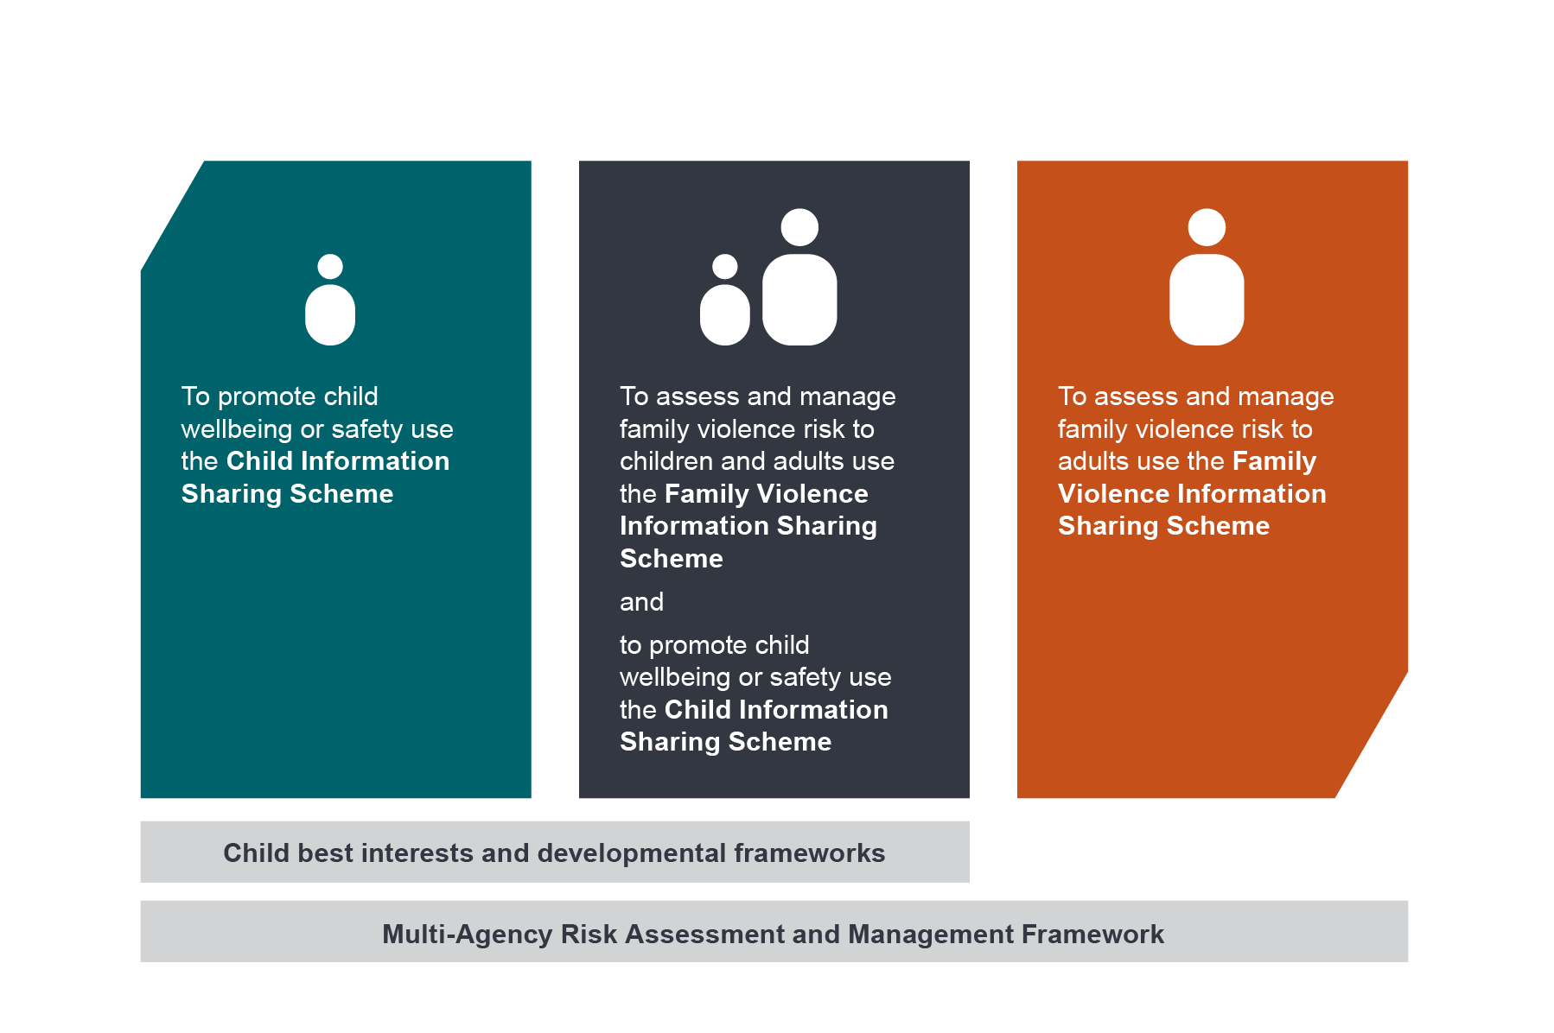
Intersection of Family Violence and Child
Information Sharing Scheme
Notes:
Under the new reforms, information can be shared to identify, assess and manage a range of wellbeing and safety needs and risks for children, families and individuals, including family violence. There is no hierarchy between the information sharing schemes – they complement each other and support professionals to work holistically and collaboratively with individuals, children and families. The diagram in this slide shows three different scenarios that would be considered for applying the information sharing schemes.
The Child Information Sharing Scheme authorises prescribed professionals and organisations known as Information Sharing Entities to share information to promote children’s wellbeing and safety.
The Family Violence Information Sharing Scheme authorises a similar group of entities and practitioners to those prescribed under the child scheme, to share information where there is a risk of family violence – whether that be with an adult client, a child or children associated with the adult.
MARAM will support information sharing entities in their roles and responsibilities to assess and manage family violence risk to better protect victim survivors and hold perpetrators to account. MARAM will guide information sharing under both the CISS and FVISS, in order to identify, assess and manage family violence risk. It will help prescribed organisations and services to understand their responsibilities in the system.
Where a child is involved, and it’s clear that sharing confidential information with another prescribed entity will benefit the child or children, practitioners would need to consider the parameters set by the Child Information Sharing Scheme.
Where it becomes apparent or the practitioner suspects that family violence exists, they must act in accordance with the responsibilities under the MARAM Framework and share information in line with the Family Violence Information Sharing Scheme. However, the connection between these three initiatives means a practitioner must not lose sight of the child’s wellbeing and would still consider using the Child Information Sharing Scheme to promote the child's wellbeing and safety risks which are not necessarily related to family violence.
After all, children who are child victim survivors of family violence may also have wellbeing needs or issues that need to be progressed and both schemes can and should be used.
Other points to note:
Professionals working with children would also be supported by child best interests and developmental frameworks.
Both information sharing schemes recognise that a child’s right to safety takes precedence over any individual’s right to privacy.
Neither scheme requires consent to share information relevant to keeping a child safe. Both schemes however, recognise the important aspect of seeking the views and wishes of both adults and children where appropriate and to recognise the agency of victim survivors.
Both schemes are compatible with existing information sharing permissions.

Slide 18
Privacy and consent
Under FVIS and CIS information sharing schemes, the safety and wellbeing of children and the safety of adult victim survivors take precedence over privacy concerns.
Consent is not required to share information about a perpetrator or an alleged perpetrator of family violence.
Consent is not required under either scheme to share any person’s information to keep a child safe.
People’s autonomy can be supported, and ethical concerns may be avoided, when clients/patients are given as much information as possible about foreseeable information disclosures.
Notes:
Information sharing is guided by a set of principles and safeguards to promote appropriate and safe information sharing. While sharing information is critical to improving outcomes, in the context of family violence it may pose particular and complex risks for children and other family members, so should be undertaken with care
An individual’s right to privacy should be upheld wherever possible, so information sharing is limited to information that is relevant to the purposes of assessing and managing the risk of family violence or promoting wellbeing and safety of a child
Both Information sharing schemes recognise the importance of seeking the views and promoting the agency of children and adults (who are not perpetrators of family violence) wherever appropriate, safe and reasonable to do so
Under the schemes, the safety and wellbeing of children and the safety of adult victim survivors takes precedence over privacy concerns
Consent is not required to share information about a perpetrator or an alleged perpetrator of family violence
Consent is not required under either scheme to share information to keep a child safe
One of the biggest impacts I anticipate for the primary care sector is the obligation to respond to requests – and the ability to share information proactively - rather than focusing on gathering information which has been the case to date
The model of the scheme is set by the legislation, which does not require consent (noting that if consent is obtained, information may already be shared under privacy law). This was designed to increase information sharing, including in circumstance where explicit permission has not been given by parents or children
Referring to the Family Violence Multi-Agency Risk Assessment and Management Framework (MARAM) will assist with identifying and guiding the assessment and management of family violence risk — for children and adults. This is to ensure that information is shared safely and lawfully, so as not to escalate family violence risk.

Slide 19
Privacy and consent
Information sharing under FVIS and CIS is limited to information that is relevant to the purposes of assessing and managing the risk of family violence or promoting the wellbeing and safety of a child.
Both information sharing schemes recognise the importance of seeking the views and promoting the agency of children and adults (who are not perpetrators of family violence) wherever appropriate, safe and reasonable to do so.
Notes:
Information sharing is guided by a set of principles and safeguards to promote appropriate and safe information sharing. While sharing information is critical to improving outcomes, in the context of family violence it may pose particular and complex risks for children and other family members, so should be undertaken with care
An individual’s right to privacy should be upheld wherever possible, so information sharing is limited to information that is relevant to the purposes of assessing and managing the risk of family violence or promoting wellbeing and safety of a child
Both Information sharing schemes recognise the importance of seeking the views and promoting the agency of children and adults (who are not perpetrators of family violence) wherever appropriate, safe and reasonable to do so
Under the schemes, the safety and wellbeing of children and the safety of adult victim survivors takes precedence over privacy concerns
Consent is not required to share information about a perpetrator or an alleged perpetrator of family violence
Consent is not required under either scheme to share information to keep a child safe
One of the biggest impacts I anticipate for the primary care sector is the obligation to respond to requests – and the ability to share information proactively - rather than focusing on gathering information which has been the case to date
The model of the scheme is set by the legislation, which does not require consent (noting that if consent is obtained, information may already be shared under privacy law). This was designed to increase information sharing, including in circumstance where explicit permission has not been given by parents or children
Referring to the Family Violence Multi-Agency Risk Assessment and Management Framework (MARAM) will assist with identifying and guiding the assessment and management of family violence risk — for children and adults. This is to ensure that information is shared safely and lawfully, so as not to escalate family violence risk.

Slide 20
Expectations under MARAM and FVIS/CIS Schemes
Under MARAM
MARAM alignment is progressive – organisations are not expected to fully align with MARAM from day one.
Organisations will be at different starting points in terms of family violence literacy and practice.

Slide 21
Expectations under MARAM and FVIS/CIS Schemes
Under the FVIS/CIS Schemes
Permitted to share information to assess and manage family violence risk (FVIS Scheme) and to promote the safety and wellbeing of children (CIS Scheme) as follows:
    Required to respond to requests made by other prescribed services and organisations if the request meets the requirements of the FVIS and CIS Schemes
    Can voluntarily share information to asses and mange family violence risk (FVIS) and to manage children’s safety and wellbeing (CIS Scheme)

Slide 22
WHAT DOES ALIGNMENT WITH MARAM MEAN?

Slide 23
MARAM alignment
Section 190 of the Family Violence Protection Act : ‘A Framework organisation that provides services relevant to family violence risk assessment and family violence risk management must ensure that its relevant policies, procedures, practice guidance and tools align with the Framework.’
The legislative instrument sets out four pillars, each with a framework requirement which framework organisations must align with.
Framework requirements should be implemented with regards to 10 key MARAM principles.
Notes:
Organisational alignment is discussed in terms of policies, procedure, practice guidance and tools aligning to MARAM. Effectively, the MARAM framework needs to be fully embedded into organisational practice, rather than a simple add-on policy or tool.
This requires extensive review of existing practice, and clear direction and planning for MARAM to be embedded.
Alignment is likened to a maturity model process, i.e. organisations are expected to align over a period of time (undefined – as this will vary for all organisations). It should be noted that a report will be tabled in Parliament annually summarising MARAM alignment activities at department level and by framework organisations. [Note: include any relevant information here about contractual requirements in funding for MARAM alignment activities]
Alignment is branched under each MARAM pillar.

Slide 24
Pillar 1:
A shared understanding of family violence
FRAMEWORK REQUIREMENT:
Framework organisations demonstrate an evidence-based, shared understanding of family violence risk and impact. A shared understanding promotes an effective, integrated service response to family violence, and comprises:
a spectrum of family violence types
evidence-based risk factors used to support determination of seriousness of risk
complexity of experiences across the community
Notes:
The contents of Pillar 1 are, in summary:
What constitutes family violence: MARAM recognises the many different presentations of family violence, both in terms of behaviours and relationships, and across communities and identities
The underlying drivers of family violence, which include structural inequalities and community attitudes: MARAM supports understanding the gendered nature of family violence, why women and children are disproportionately affected and the drivers of family violence (why a person chooses to use violence); MARAM also recognises the additional drivers of structural inequality and discrimination
Evidence-based family violence risk factors: knowing what the MARAM risk factors are and which particular risk factors increase the risk of lethality or serious harm. This is essential for screening, assessing and managing the level of family violence risk
Recognising children as victim survivors in their own right: acknowledging children and young people individually, and recognising their unique experiences, vulnerabilities and needs
An intersectional approach to family violence: MARAM recognises the different experiences of family violence within and across communities, and examines how an individual’s different identities (i.e. sexuality, age, disability) affect how violence is used against them and how they experience family violence and how it may influence their presentation, needs and ability to engage with services
A trauma and violence informed approach: understanding how different experiences of trauma affect an adult and a child victim survivor’s presentation, needs and ability to engage with services
Shared responsibility to keep perpetrators in view and accountable: this includes monitoring a perpetrator’s behaviour, sharing information to reduce the risk to a victim survivor and avoiding collusion (even if inadvertent)
The MARAM Framework requires a shared understanding of family violence.
A common language enables disparate services providers understand each other and are working towards a common goal.
Family violence, as per the FVPA, includes physical assault and range of non-physical behaviours that occur in the context of power and control.
What constitutes ‘family’ is also important.
This incudes:
Intimate partners and former partners
Parents and children
Extended family including grandparents, uncles, aunties, and cousins
Kinship relationships, particularly in Aboriginal and Torres Strait Islander communities
And other relationships that approximate family such as some carer relationships.

Slide 25
Pillar 1:
What does this mean for our organisation?
Update policies, procedures, practice guidance and tools to:
      reflect the understanding of family violence as contained in the MARAM Framework.
      make known the evidence-based risk factors to determine seriousness of risk.
      take into account the different experiences and impacts of family violence across communities.
Notes:
[Note: this slide will have more impact if it is updated to be organisation specific – highlight specific examples of what your organisation will need to do in order to further MARAM alignment to this Pillar].

Slide 26
Pillar 1:
What does this mean for our organisation?
          Create a shared understanding of family violence within the workforce:
      update staff training and induction processes
      create a welcoming and safe environment for staff members and service users
      ensure foundational family violence knowledge is available to staff members in their practice environment
Notes:
[Note: this slide will have more impact if it is updated to be organisation specific – highlight specific examples of what your organisation will need to do in order to further MARAM alignment to this Pillar].

Slide 27

Family Violence
Evidence-based risk factors
Risk factors relevant to adult victim circumstances
Physical assault while pregnant/following new birth *
Self-assessed level of risk
Planning to leave or recent separation*
Escalation – increase in severity and/or frequency of violence *
Financial abuse/difficulties
Imminence.
Risk factors for adult or child victims caused
by perpetrator behaviours
Controlling behaviours *
Access to weapons *
Use of weapon in most recent event *
Has ever harmed or threatened to harm victim or family members
Has ever tried to strangle or choke the victim *
Has ever threatened to kill victim *
Has ever harmed or threatened to harm or kill pets or other animals *
Has ever threatened or tried to self harm or commit suicide *
Stalking of victim *
Sexual assault of victim *
Previous or current breach of court orders/Intervention Order
History of family violence
History of violent behaviour (not family violence)
Obsession/jealous behaviour towards victim *
Unemployed / disengaged from education *
Drug and/or alcohol misuse/abuse *
Mental illness/depression
Isolation
Physical harm
Emotional abuse
Property damage.
Risk factors specific to children caused by perpetrator behaviours
Exposure to family violence
Sexualised behaviours towards a child by the perpetrator
Child intervention in violence
Behaviour indicating non-return of child
Undermining the child–parent relationship
Professional and statutory intervention.
Risk factors specific to children’s circumstances
History of professional involvement and/or statutory intervention
Change in behaviour not explained by other causes
Child as victim in other forms of harm.
Note: bold text denotes increased risk of the victim being killed or almost killed. Risk assessment tools are designed from these evidence-based factors, using structured professional judgement to determine seriousness of presenting risk.
Notes:
International evidence-based reviews and consultation with academics and expert practitioners have informed the development of evidence-based risk factors. Emerging risk factors are highlighted in the MARAM Framework, and evaluation and validation of factors will be undertaken to continue to strengthen the evidence base for the Victoria’s system.
All professionals with MARAM responsibilities need to be familiar with the risk factors and these risk factors need to be reflected in any screening or risk assessment tools used in respect of family violence.

Slide 28
Pillar 2:
Consistent and collaborative practice
FRAMEWORK REQUIREMENT:
Framework organisations use a shared approach to identification, screening, assessment and management of family violence risk.
Framework organisations use tools that are consistent with the evidence-based risk factors, and share information relevant to family violence risk assessment and management with other services in accordance with relevant laws.
Seriousness of risk is to be assessed through structured professional judgement, which comprises a victim’s self-assessed level of risk, fear and safety, assessment against evidence-based risk factors, information sharing to inform assessment and professional judgement.
Notes:
To assist with alignment to Pillar 2 there are MARAM aligned tools for use in the identification, screening, assessment and management of family violence attached to the MARAM Practice Guides. These tools incorporate the evidence-based risk factors.
These tools can be used by being adopted in full or adapted into existing tools as best fits the Framework organisation. Any adaption should ensure retention of the evidence-based factors as a minimum requirement.
The MARAM Framework requires a shared understanding of family violence.
A common language enables disparate services providers understand each other and are working towards a common goal.
Family violence, as per the FVPA, includes physical assault and range of non-physical behaviours that occur in the context of power and control.
What constitutes ‘family’ is also important.
This incudes:
Intimate partners and former partners
Parents and children
Extended family including grandparents, uncles, aunties, and cousins
Kinship relationships, particularly in Aboriginal and Torres Strait Islander communities
And other relationships that approximate family such as some carer relationships.

Slide 29
Pillar 2:
What does this mean for our organisation?
          Establish procedures for the identification, screening, assessment and management of family violence risk that utilises the evidence-based risk factors.
          Use MARAM-aligned tools to create a consistent and collaborative practice.
          Share risk-relevant information including making requests, responding to requests and proactively sharing information, noting new schemes for sharing of family violence information (FVIS Scheme).
Notes:
[Note: this slide will have more impact if it is updated to be organisation specific – highlight specific examples of what your organisation will need to do in order to further MARAM alignment to this Pillar].

Slide 30
Pillar 2:
What does this mean for our organisation?
          Seek and provide secondary consultations and referrals for the purpose of assessing and managing risk.
          Build strong partnerships with relevant external organisations to promote a coordinated and collaborative response to family violence risk.
          Embed structured professional judgement as the method to assess family violence risk.
Notes:
[Note: this slide will have more impact if it is updated to be organisation specific – highlight specific examples of what your organisation will need to do in order to further MARAM alignment to this Pillar].

Slide 31
Pillar 3:
Responsibilities for risk assessment and management
FRAMEWORK REQUIREMENT:
Framework organisations understand their responsibilities in risk assessment and management practice and those these relate to the operation of Part 5A of the Family Violence Protection Act 2008, as applicable.
Framework organisations assign responsibilities of services and service providers within them in accordance with the 10 MARAM responsibilities.
Notes:
Part 5A relates to information sharing for the purpose of family violence assessment and family violence protection.
Framework organisations are required to understand which of the 10 MARAM Responsibilities apply to their organisation and equip their workforces with the necessary tools, resources and training to meet those responsibilities.
The MARAM Framework requires a shared understanding of family violence.
A common language enables disparate services providers understand each other and are working towards a common goal.
Family violence, as per the FVPA, includes physical assault and range of non-physical behaviours that occur in the context of power and control.
What constitutes ‘family’ is also important.
This incudes:
Intimate partners and former partners
Parents and children
Extended family including grandparents, uncles, aunties, and cousins
Kinship relationships, particularly in Aboriginal and Torres Strait Islander communities
And other relationships that approximate family such as some carer relationships.

Slide 32
10 responsibilities
– within Pillar 3 of MARAM
Notes:
[Note: This slide can be used to highlight the Responsibilities that apply to your organisation]

Slide 33
Pillar 3:
What does this mean for our organisation?
Responsibilities:
    Identify and map the MARAM responsibilities specific to the organisation.
    What procedures need to be in place to enable the responsibilities to be met during usual course of practice.
    Staff awareness:
    Ensure staff are informed about the MARAM responsibilities and updating on their roles and functions.
    Staff training:
    Identify and execute an appropriate training plan and tailor any training to the workforce to help raise capability.
Notes:
[Note: this slide will have more impact if it is updated to be organisation specific – highlight specific examples of what your organisation will need to do in order to further MARAM alignment to this Pillar].

Slide 34
Pillar 4:
Responsibilities for risk assessment and management
FRAMEWORK REQUIREMENT:
Framework organisations:
Establish or utilise existing relevant governance and advisory structures to implement the Framework
Collect consistent information about (a) the evidence-based risk factors, through MARAM aligned tools (b) service users’ individual experience of the forms of family violence
Undertake activities to change organisational culture and practice to promote continuous improvement in risk assessment and management practice, information sharing and enhanced collaboration with other services
Notes:
Pillar 4 outlines the requirements as well as the benefits to Framework organisations in aligning to MARAM, and participating in data collection and evaluation of family violence response. It outlines how organisational leaders can contribute to the implementation of MARAM, to continuous improvement and an understanding of the evidence base over time.
It should be noted that Pillar 4 reiterates that alignment to MARAM requires a significant culture change and systemic reform which will take time. The collection of data and evaluation is part of this ongoing process.
The MARAM Framework requires a shared understanding of family violence.
A common language enables disparate services providers understand each other and are working towards a common goal.
Family violence, as per the FVPA, includes physical assault and range of non-physical behaviours that occur in the context of power and control.
What constitutes ‘family’ is also important.
This incudes:
Intimate partners and former partners
Parents and children
Extended family including grandparents, uncles, aunties, and cousins
Kinship relationships, particularly in Aboriginal and Torres Strait Islander communities
And other relationships that approximate family such as some carer relationships.

Slide 35
Pillar 4:
What does this mean for our organisation?
Implement the MARAM Framework: using governance or other structures; ensure there is a clear process for alignment.
Collect data: on the identity of those experiencing family violence, the forms of violence, recording information sharing practices
Change organisational culture and practice: embed into the organisational culture the understanding that family violence is unacceptable in any form, and respond and manage family violence risk as a collective responsibility
Continually improve: regularly review alignment progress and identify opportunities to update and improve policies, procedures, practice guidance and tools (particularly as the evidence base for family violence develops).
Notes:
[Note: this slide will have more impact if it is updated to be organisation specific – highlight specific examples of what your organisation will need to do in order to further MARAM alignment to this Pillar].

Slide 36
WHAT NEXT?

Slide 37
Priorities for Managers
Clear leadership
Implementation plan for organisational embedding
Facilitate consistent and collaborative practice through operational changes
Build staff capacity
Build multi-agency collaboration and practice
Mechanisms in place for continuous improvement
Notes:
Clear leadership
Leaders provide clear and consistent leadership that encourages a shared understanding of risk, respects sector expertise and cultivates trust across organisations.
Facilitate consistent and collaborative practice
Leaders ensure organisations have operational procedures that enable the timely identification of risk, information sharing and consistent and collaborative practice.
Build staff capacity
Organisations ensure staff across sectors will be supported to build their capacity, skills and practice knowledge to identify and manage risks and share information effectively in line with their roles and expertise.
Build multi-agency collaboration and practice
Information sharing, multi-agency collaborative practice, referrals, secondary consultations – all go to improve risk assessment and management response. This needs to be lead at a leadership level through strengthening local relationships, participating in relevant government groups and forums, memorandums of understanding where appropriate.
Continuous improvement
Organisations ensure mechanisms for sharing lessons learned across sectors are in place to reinforce good practice
Organisations collecting reliable and accurate data can use this to evaluate their own response to family violence and identify opportunities for continuous improvement. Data collection on a larger scale can help build a strong evidence base about risk and forms of family violence experiences. This will help inform policy and decision-making across the service system.

Slide 38
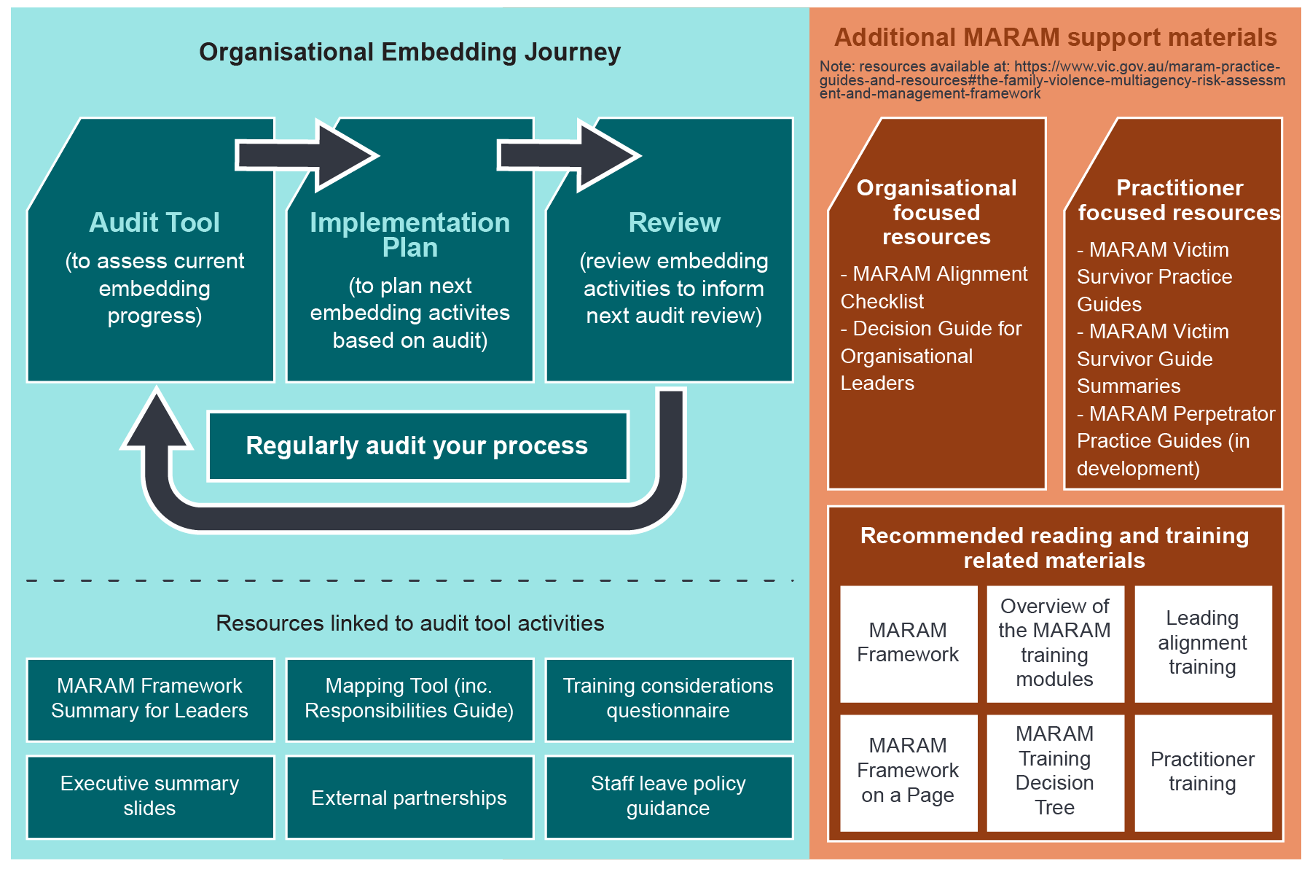
Where do we begin with MARAM alignment?
Notes:
[Insert own proposals for how your organisation should progress MARAM alignment activities. These slides are suggested based on the organisational embedding guide]
Organisational embedding guidance sets out a roadmap for alignment to MARAM, through the use of three key tools, and associated further supporting resources.
Step 1: Audit current alignment progress by using an audit tool. This enables an organisation to assess its progress against key milestones (linked to the four pillars). It contains examples of best practice to demonstrate what we are working towards. It is likely to be completed collaboratively with input from key managers and stakeholders to determine where our current alignment progress is.
Step 2: Based on the identified progress and gaps in the audit tool, the second step is to identify what we as an organisation want to work on over the next project cycle. It is for us to determine what we want to focus on and what makes the most sense for our organisation based on where we are.
Step 3: Review the success of our implementation activities through staff surveys, random case reviews, and data analysis as available within our systems.
Then we return to the audit tool to reassess our progress and start the journey again. This supports continuous improvement under Pillar 4.
The infographic refers to the various tools and resources available to assist. The orange column refers to existing resources that exist categorised as organisational and practitioner resources. These are useful for alignment activities. The lower orange box refers to key reading and training pieces. The blue resources are those that were created specifically from the organisational embedding guidance and help with meeting specific milestones.
The MARAM Framework requires a shared understanding of family violence.
A common language enables disparate services providers understand each other and are working towards a common goal.
Family violence, as per the FVPA, includes physical assault and range of non-physical behaviours that occur in the context of power and control.
What constitutes ‘family’ is also important.
This incudes:
Intimate partners and former partners
Parents and children
Extended family including grandparents, uncles, aunties, and cousins
Kinship relationships, particularly in Aboriginal and Torres Strait Islander communities
And other relationships that approximate family such as some carer relationships.

Slide 39
Proposed Next Steps
Notes:
[Create a slide setting out your proposed next steps for your organisational leaders]
The MARAM Framework requires a shared understanding of family violence.
A common language enables disparate services providers understand each other and are working towards a common goal.
Family violence, as per the FVPA, includes physical assault and range of non-physical behaviours that occur in the context of power and control.
What constitutes ‘family’ is also important.
This incudes:
Intimate partners and former partners
Parents and children
Extended family including grandparents, uncles, aunties, and cousins
Kinship relationships, particularly in Aboriginal and Torres Strait Islander communities
And other relationships that approximate family such as some carer relationships.

