Slide 1

ADULT, COMMUNITY AND FURTHER EDUCATION BOARD
EXPRESSION OF INTEREST PROCESS
FOR 2023 ACFE BOARD TRAINING DELIVERY
August - September 2022

Slide 2
ACKNOWLEDGEMENT OF COUNTRY
We acknowledge the Traditional Owners of the land on which we are meeting. We pay our respects to their Elders, past, present and emerging and the Aboriginal Elders of other communities who may be here today.
You can use the interactive map in this link to locate and acknowledge the Formally Recognised Traditional Owners of the land you are on:
https://achris.vic.gov.au/weave/wca.html

Slide 3
WHAT WILL BE COVERED IN TODAY’S SESSION
1
2
3
4
5
Resources and supports
Next Steps
Overview
Roles and Priorities
Purpose of ACFE Training Delivery
Program delivery streams
How to apply -
EOI process and timelines
Digital Skills
General Pre-accredited
Reporting and payments

Slide 4
OVERVIEW

Slide 5

STRATEGIC CONTEXT
The Learn Local sector plays a vital role in changing the lives of Victorians each year by supporting learners to achieve their goals.
The Learn Local modules (courses) that you all deliver every day, make a real difference in people’s lives. We know how hard you and your teams work to ensure each and every learner has an opportunity to achieve their goals.
There is a wealth of great examples on the Learn Local social media channels:
Learn Local website (for learners): www.learnlocal.org.au
Twitter: www.twitter.com/learnlocal
YouTube: www.youtube.com/learnlocal
The delivery of ACFE Board-funded training programs is a core component of this work. This EOI begins the planning and allocation process for ACFE training delivery in 2023.

Slide 6

CENTRAL RESOURCES
In addition to your local modules, centrally developed training resources and other supports are available. Many of these resources are available now on the Learn Local Secure Portal:
Digital Essentials (2 modules)
Digital Skills for Jobseekers (4 modules)
Digital Skills for the Workplace (7 modules)
Pathways to TAFE (11 modules)
Industry contextualised Skills for Work and Study training (7 modules).
These will be updated as new materials come on line.
These can be adapted to meet local community needs. We encourage you to look at these resources as well as your own, when planning your EOI responses.
Details and links are in the Program Table (Attachment 1), which accompanies the 2023 ACFE Training Delivery Guidelines. Both of these are on the Learn Local website.

Slide 7
COVID-19
The work of the Learn Local sector is important in supporting learners to effectively engage and participate in pre-accredited training in a COVID-normal environment. Each one of you have an opportunity to help your local community recover from the ongoing impact of COVID-19.
The ACFE Board continues to monitor ongoing impacts and issues and to actively consider any necessary actions.
The transition to online and blended learning which has taken place during COVID-19, continues to be a critical method of training delivery in 2023.
Keep in mind the potential need for flexibility when planning your training delivery in 2023, given the ongoing potential for COVID challenges.

Slide 8
ACFE TRAINING DELIVERY ROLES AND PRIORITIES

Slide 9

ACFE BOARD AND REGIONAL COUNCIL ROLES
ACFE Board
The role of the ACFE Board is to plan and promote adult learning, allocate resources, develop policies, and advise the Minister for Training and Skills and Higher Education on matters related to adult education in Victoria.
Through the Board, the Victorian Government provides funding to Learn Local providers, AMES Australia and the CAE, to deliver education and training programs to a broad range of Victorians over compulsory school-leaving age, with a special focus on people who have had limited prior access to education.
Regional Councils
Using their different expertise and local knowledge about adult education, Regional Councils advise the ACFE Board on the needs of adult education across their region.
They also contribute to state-wide planning and policy development and advocate on behalf of the ACFE sector.

Slide 10
2023 ACFE TRAINING DELIVERY PRIORITIES
ACFE Board Strategy 2020-25
Pre-accredited programs must reflect the Board’s strategic priorities outlined in the ACFE Board Strategy 2020-25.
The Strategy is a primary means to implement the Ministerial Statement on the Future of Adult Community Education in Victoria 2020-25.
The ACFE Board has identified people who have experienced educational disadvantage as a priority in the design and delivery of pre-accredited programs.
Digital Skills
Through the Victorian Budget 2021-22, the Government has identified digital skills as a priority, to tackle the digital skills divide facing educationally disadvantaged Victorians.
Training delivery hours are available in this EOI for the second year of this two-year funding to support delivery of digital skills modules, in addition to General Pre-accredited hours. Digital Skills includes the Digital Literacy Essentials and Digital Skill for Employability program categories.

Slide 11
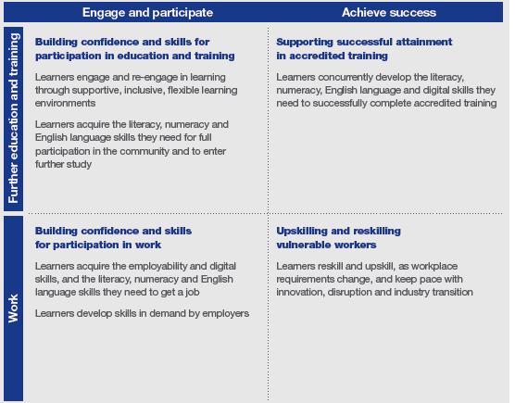
KEY ROLES FOR ACFE TRAINING
Contracted providers are expected to deliver pre-accredited modules (courses) aligned to one or more of the four roles outlined in the ACFE Board Strategy 2020-25 (p8):

Slide 12
PURPOSE OF ACFE TRAINING DELIVERY

Slide 13






ACFE TRAINING DELIVERY
The primary purpose of pre-accredited education and training is to provide opportunities for adult learners in Victoria to gain the educational capacity and core skills they need for study, work and life.
Pre-accredited education and training addresses the particular needs of adults who have experienced barriers to education in the past.
Pre-accredited training programs focus on creating pathways for learners to further education and training or a pathway to employment.
Programs are designed to be flexible, meet learners’ needs and support them to return to study, improve their literacy and numeracy skills, their qualification pathways and broaden their employment options.

Slide 14

THE PRE-ACCREDITED QUALITY FRAMEWORK
All modules on your Delivery Plan must meet the requirements of the Pre-accredited Quality Framework (PQF).
The PQF is a system of interrelated processes that ensure quality and continuous improvement in the cycle of planning, developing, implementing and reviewing pre- accredited courses.
The PQF supports teachers and managers to plan, develop, teach and review pre-accredited courses.
Key components of the PQF
A-frame
Pre-accredited module planning resource
Evaluation
Includes the processes and documentation for moderation and verification

Slide 15
THE PRE-ACCREDITED QUALITY FRAMEWORK
Pre-accredited modules (courses) must be designed and delivered in accordance with the Pre-accredited Quality Framework (PQF), using the required tools and principles, to be eligible for funding. These include:
centrally developed modules (courses)
modified centrally developed modules (more than 30% change is a new locally developed module)
new locally developed modules
existing locally developed modules.
The centrally developed modules (courses) have been developed to align with PQF requirements and have been subject to a centralised quality assurance process. Providers are encouraged to use these quality-assured and centrally developed curriculum and resources.

Slide 16
ACFE TRAINING DELIVERY EXPRESSION OF INTEREST PROCESS AND TIMELINE

Slide 17
PROVIDER ELIGIBILITY
To be eligible to receive funding for government subsidised pre-accredited training, providers must have:
ACFEB Registration
AMES Australia and CAE are covered under the Education and Training Reform Act 2006.
Trained Staff to use your SMS and SVTS
Current Business and Governance Status (BGS) or
Have a current Skills First contract to deliver government subsidised accredited training.
An AVETMISS-compliant Student Management System
Delivery Plan and A-frames aligned with the ACFEB Strategy 2020-25
SAMS2 Registration

Slide 18
LEARNER ELIGIBILITY
 |  | ELIGIBILE | NOT ELIGIBLE
ELIGIBLE LEARNERS | Australian Citizen, or Holder of an Australian permanent visa New Zealand citizen Asylum seekers holding valid visa that confers eligibility for Skills First training.
 | Holder of an Australian permanent visa
 | New Zealand citizen
 | AND:
 | Meets age requirement 17 and over and not enrolled at school Under 17 and not enrolled at school with exemption.
 | Under 17 and not enrolled at school with exemption
 | If documentation unavailable Where no documentation confirming citizenship and/or age can be produced, an authorised delegate of the training provider can grant eligibility on face value, via interview.
 |  | ELIGIBILE | NOT ELIGIBLE
INELIGIBLE LEARNERS | A prisoner held at a prison, within the meaning of the Corrections Act 1986. |  | ✗
 | Detained under the Mental Health Act 1986; or the Crimes (Mental Impairment and Unfitness to be Tried) Act 1997 or the Sentencing Act 1991 at the Thomas Embling Hospital. |  | ✗
 | Detained (other than on weekend detention) under the Children, Youth and Families Act 2005 or the Sentencing Act 1991 or who is held on remand in the Malmsbury Juvenile Justice Centre or Parkville Youth Residential Centre. |  | ✗
 | Non-citizenship/permanent residents and Asylum seekers not listed in the previous table. |  | ✗

Slide 19


PROCUREMENT BY EXPRESSION OF INTEREST
The EOI process has been streamlined for 2023.
There are two program streams available:
Digital Skills - funded from the Victorian Budget 2021-22.
    Digital Literacy Essentials
    Digital Skills for Employability
    Short modules
General Pre-accredited Training - funded from the ACFE Pre-accredited Training Budget.
    Language
    Literacy and Numeracy
    Employability
    Vocational
    Short modules
In 2023, there will be no Learner Engagement A-frame Program (LEAP). However, there will be a Short Module program category in both Digital Skills and General Pre-accredited training. Short Modules are 5-15 hours in length.
The ACFE Board has allocated student contact hours for General Pre-accredited Training and Digital Skills, across the 8 ACFE regional areas under a fixed annual budget. These hours are distributed through the Expression of Interest (EOI) process.

Slide 20
HOW TO APPLY FOR ACFE PROGRAM TRAINING DELIVERY FUNDING
EOI OPENED 29 AUGUST AND CLOSES ON 16 SEPTEMBER 2022
Download and read the ACFE 2023 Training Delivery Guidelines
Download the ACFE 2023 Delivery Plan template
Complete the 2023 ACFE Delivery Plan by LGA and program stream. Please ensure you list your modules in order of priority.
Prepare a full A-frame including Module Plans and Session Plans for new locally developed pre-accredited modules. Ensure you have a Module Plan for existing modules. For centrally developed modules, use the existing A-frames.
Submit your EOI Delivery Plan by COB 16 September 2022 via email to: training.participation@education.vic.gov.au
A-frames can be submitted with the Delivery Plan or separately by Tuesday, 15 November 2022. You do not need to submit A-frames for centrally developed modules.
1
2
3
4
5
6

Slide 21
DELIVERY PLAN
The 2023 Delivery Plan Worksheet template has been simplified based on Learn Local provider feedback and is similar to the 2021 Delivery Plan template. It enables Learn Locals to manually input and amend module information, but still includes some automated features.
The 2023 Delivery Plan template will be in the form of an Excel workbook with four visible tabs:
Tab 1 – Guide to completing your Delivery Plan Worksheet
Tab 2 – 2023 Delivery Plan Summary (Summary)
Tab 3 – 2023 General Pre-accredited Delivery Plan Worksheet
Tab 4 – 2023 Digital Skills Delivery Plan Worksheet.

Slide 22
HOW TO SUBMIT AN EXPRESSION OF INTEREST
To submit your EOI, complete a draft Delivery Plan EOI which clearly indicates the number of SCH in each training delivery program stream (General Pre-accredited and Digital Skills) by LGA, that you are requesting.
To develop your Delivery Plan you need to complete tab 3 (General Pre-accredited Delivery Plan Worksheet) and/or tab 4 (Digital Skills Delivery Plan Worksheet) as appropriate, with your proposed modules. These figures will be automatically generated on the Summary tab (2) as you complete the two Worksheets. Please complete your organisation details in the Summary tab.
While final details of individual modules are not required until a later date, we do need a final request of SCH by program stream and LGA by 16 September 2022. You will then be able to continue to modify how these hours are allocated by individual module on your Delivery Plan Worksheet(s).
Your proposed Delivery Plan will be considered for its alignment with the ACFE Board Strategy 2020-25, the intent, content and quality of proposed courses and the demand for training in each LGA.

Slide 23
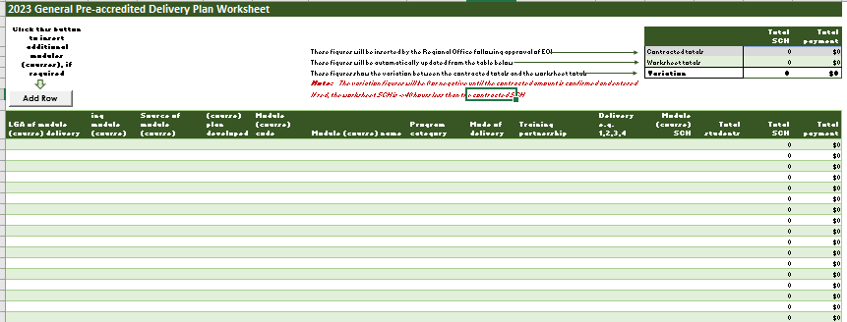
DELIVERY PLAN
TAB 3 - GENERAL PRE-ACCREDITED WORKSHEET

Slide 24
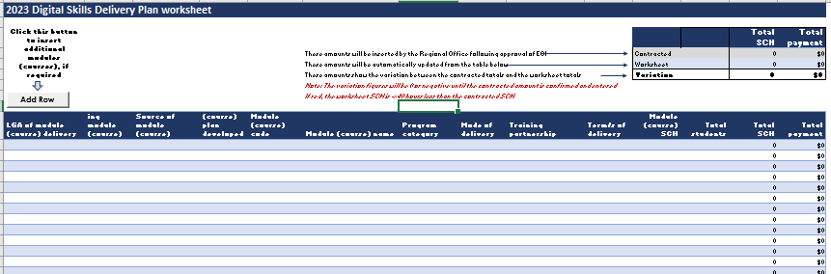
DELIVERY PLAN
TAB 4 – DIGITAL SKILLS WORKSHEET

Slide 25
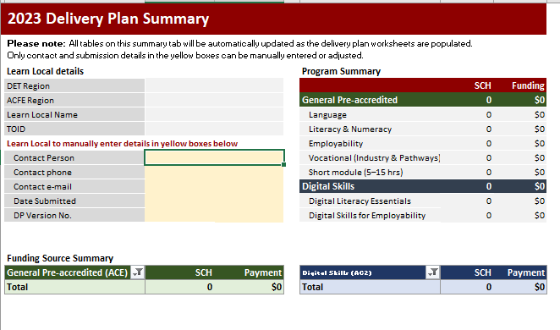
DELIVERY PLAN
TAB 2 - SUMMARY

Slide 26
DELIVERY PLAN ASSISTANCE
Where can I find more information or get help?
Guidance instructions are included in the Delivery Plan template at tab 1.
2023 ACFE Training Delivery Guidelines.
More information on the 2023 Delivery Plan template will be provided at the Regional Forums that are being prepared for September 2022.
The Delivery Plan template will be on the Learn Local website at: http://www.vic.gov.au/pre-accredited-training-and-programs.
Contact your regional office.

Slide 27
DIGITAL SKILLS

Slide 28
DIGITAL SKILLS
Funding through the Victorian Budget 2021-22 provides additional training places in 2023 as the second year of the 2-year tackling the digital skills divide initiative.
These additional places are available under 3 program categories:
Digital Literacy Essentials
Digital literacy modules that provide adult Victorians with the entry-level digital skills required to make basic use of digital devices and online applications. This includes the centrally developed modules Digital Essentials Level 1 and Digital Essentials Level 2, available on the Learn Local Secure Portal, as well as locally developed A-frames and resources.
Digital Skills for Employability
Digital literacy modules with a specific focus on employability, providing adult Victorians with core employability skills training which embed a digital component. This includes centrally developed modules available on the Learn Local Secure Portal.
Short Modules
The short module program category includes 5-15 hour modules with a focus on engagement as well as short, sharp digital, vocational and employability skills, including ‘bolt-on’ modules that can be appended to other pre-accredited modules.
Further details: Attachment 1, Program Table in the 2023 EOI Guidelines, which links to the Learn Local Secure Portal.

Slide 29
DIGITAL SKILLS
Assessment Criteria:
Allocation of hours by LGA and training delivery program stream
reflects Digital Skills initiative strategic priorities and implementation strategy
equitable allocation of resources across the state according to learner demand
relevance of the proposed module to the Local Government Area (LGA) including local community needs and regional area priorities
the provider’s history of delivery to contract
capacity of the provider to meet delivery and reporting standards.
Assessment of module delivery, against strategic priorities and PQF
alignment to the ACFE Board Strategy 2020-25
quality of Module Plans and Session Plans, if not using centralised resources
clear evidence that the proposed module aligns to one or more of the four key roles of providers in meeting the needs of learners
the module will either deliver
  general digital literacy skills or
  digital skills for employability
the course is targeted at the needs of educationally disadvantaged adults
evidence of course evaluation/moderation, if not using a centralised resource.

Slide 30
GENERAL PRE-ACCREDITED TRAINING

Slide 31
GENERAL PRE-ACCREDITED TRAINING
General pre-accredited training provides opportunities for adult Victorians to gain the educational capacity and core skills they need for study, work and life.
Locally developed General Pre-accredited training modules must be consistent with the Pre-accredited Quality Framework.
There are also centrally developed modules available on the Learn Local Secure Portal.
These include Skills for Work and Study and Pathways to TAFE modules.
Program categories:
Note: The Digital Literacy program category will not be used for General Pre-accredited in 2022 as it will be delivered under the Digital Skills program funding stream.
Language | includes courses focused on speaking, reading and writing English for learners who speak English as an additional language
Literacy and Numeracy | includes courses focused on reading and writing everyday texts, including digital texts and/or using maths in everyday life, either localised or Skills for Work and Study
Employability | includes courses focused on assisting learners to develop and improve their core and transferable skills to engage in the workplace
Vocational | includes courses focused on assisting learners to develop their understanding and/or skills in a specific industry or employment sector
Short Modules | Includes short modules of 5-15 hours in length. This includes a focus on engagement as well as short, sharp digital, vocational and employability skills, including ‘bolt-on’ modules that can be appended to other pre-accredited modules.

Slide 32
GENERAL PRE-ACCREDITED TRAINING
Assessment criteria:
Allocation of hours by LGA and training delivery program stream
equitable allocation of resources across the state according to learner demand
relevance of the proposed module to the Local Government Area (LGA) including local community needs and regional area priorities
the provider’s history of delivery to contract
capacity of the provider to meet delivery and reporting standards.
Assessment of module delivery, against strategic priorities and PQF
alignment to the ACFE Board Strategy 2020-25
quality of Module Plans and Session Plans, if not using centralised resources
clear evidence that the proposed module aims to lead to further education, training or employment
evidence that the proposed module is aligned to one or more of the roles specified in the ACFE Board Strategy 2020-25
the module is targeted at the needs of educationally disadvantaged adults
evidence of module evaluation/moderation, if not using a centralised resource.

Slide 33
REPORTING

Slide 34
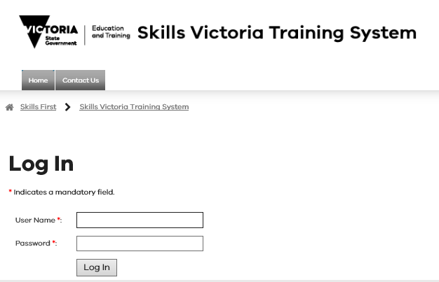
Reporting – acfe TRAINING DELIVERY (SVTS)
Note there are separate reporting guidelines for all 2023 ACFE Board funded training delivery, which will be on the Learn Local website.
It is your responsibility to accurately report the delivery of ACFE training programs, in accordance with the agreed Delivery Plan.
Accurate reporting is essential to assist the ACFE Board in understanding and responding to community need for pre-accredited training delivery.

Slide 35
PAYMENTS AND REPORTING SCHEDULE
The SCH subsidy rate will remain at $9.10 in 2023.
The Training Delivery Support Grant will be $5,500.
Fee Concessions – The ACFE Board will reimburse providers for a proportion of the revenue foregone by granting fee concessions to learners in pre-accredited courses, based on reported data in SVTS.
Regional Loading – 20 per cent loading on regional delivery paid in two instalments: in May 2023 based on contracted allocations, and in 2024 based on end-of-year 2023 SVTS reported data.
Koorie loading: a 50 per cent loading on delivery will be paid in May 2023 and early 2024, based on SVTS reported data.
2023 Payment & Reporting Schedule
Milestone no. | Milestone Processing date | Payment percentage (%) | Cumulative payment percentage (%) | Requirement for release of payment
1 | February | 35% | 35% | Contract execution with approved BGS
2 | April | 25% | 60% | 25% enrolments reported by 31 March
3 | May | 0% | 0% | Non-financial progress report by 31 May
4 | August | 20% | 80% | 55% enrolments reported by 31 July
5 | October | 20% | 100% | 75% enrolments reported by 30 September

Slide 36
NEXT STEPS

Slide 37
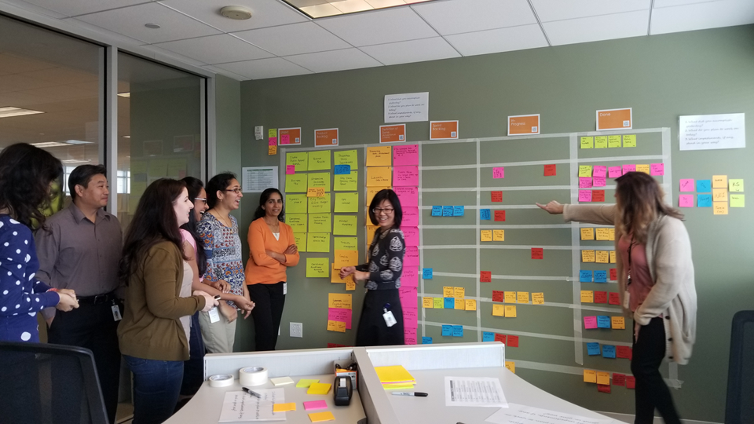
REGIONAL FORUMS
To help you in developing your Delivery Plans, a number of forums focussing on contracting workshops will be scheduled across regions following these information sessions.
Regional staff will be available at the forums to provide advice and support on how to complete your delivery plans.
Regional Forums will be held in September 2022.
You are encouraged to attend, particularly if you have any questions about the new Delivery Plan.
Please contact your Regional Office for further information.

Slide 38
TIMELINES & NEXT STEPS
29 August 2022
Read and action the Memo, to commence the ACFE 2023 Training Delivery EOI process.
30 August or 7 September 2022
Participate in an Information Session and review the information on the website.
Throughout September 2022
Attend a regional forum for assistance with contracting or to discuss partnership options with other Learn Locals in your region. Registration details will be emailed to providers.
29 August 2022
Download the 2023 Guidelines for the program you are applying for and the 2023 Delivery Plan Template from the website.
30 September 2022
Ensure you have a current BGS and financial statements uploaded in SAMS2 system.
By 16 September 2022
Complete & submit your Delivery Plan EOI in ONE email and if applicable A-frames, to: training.participation@education.vic.gov.au
By 15 November 2022
A-frames can be submitted. You are not required to submit A-frames for centrally developed modules.
February 2023
First payment, where all contract requirements are met.
By late October 2022
Regional Office staff will review your Delivery Plan and confirm contracted delivery by LGA and program stream with you.
December 2022
Contracts will be uploaded into SAMS2.

Slide 39

NOTIFICATIONS OF OUTCOMES
Notifications and Outcomes
Providers will be formally notified via email regarding assessment of their Delivery Plan EOI, and the approved funding outcome by late October 2022.
Contracts will be uploaded into SAMS2 in December 2022.
Check and ensure that your organisation’s contact details and signatories are up to date in SAMS2, to ensure timely contracting.

Slide 40
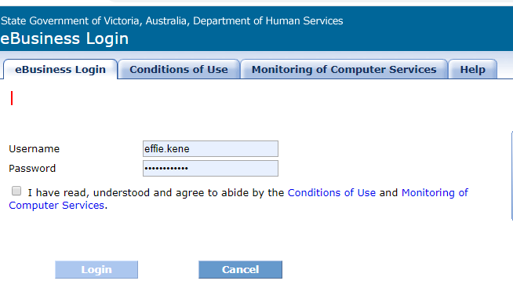
CONTRACTING (SAMS2)
SAMS2 - SERVICE AGREEMENT
Providers are contracted via a Service Agreement in SAMS2.
Service Plan
Service Plans are listed within the Service Agreement. Digital Skills and General Pre-accredited Training Delivery will be listed as separate Service Plans.
SUBCONTRACTING
As per ACFE Board procurement policy, Learn Locals who are contracted to deliver training in a given year must not outsource this training to another organisation.

Slide 41
DELIVERY PLAN VARIATIONS AND ADJUSTMENTS
vARIATIONS
Approval must be obtained for all variations to contracted Delivery Plans by the Department before making any changes and commencing delivery.
A variation to the Delivery Plan that includes changes to LGA and/or program stream targets or payments, can only be requested during a formal variation window. Advice on variation windows will be provided during the year.
Please ensure the Chairperson (or approved delegate) of your organisation approves any variation prior to submitting a request.
ADJUSTMENTS
You can make adjustments to module delivery on the Delivery Plan Worksheet through negotiation with your Regional Manager, where this does not impact on LGA and/or program stream targets or payments.

Slide 42
CHECK LIST
Important EOI details to check:
Current BGS and financial statements completed and uploaded in SAMS2 by 30 September 2022.
Contact details and signatory up to date in the Delivery Plan and in SAMS2.
Ensure Delivery Plan EOI for all program streams is submitted in ONE email to training.participation@education.vic.gov.au by 16 September 2022.
Following EOI submission, ensure you receive an acknowledgement of your EOI application.
Ensure you have agreed on an approved Delivery Plan by late October, if not please contact your Regional Office.

Slide 43
THANK YOU
We’ll review your questions from the chat, and provide a Frequently Asked Questions document on the Learn Local website, along with these slides.

