Slide 1

About the Nazi Hakenkreuz symbol ban
Key information on the new legislation

Slide 2
Overview
From 29 December 2022, it is illegal to intentionally display the Nazi Hakenkreuz symbol in public.
Hindu, Buddhist, Jain, and other faith communities have long used the sacred Swastika as an auspicious symbol of purity, love, peace and good fortune. The sacred Swastika can continue to be publicly displayed for genuine cultural or religious purposes.
The Nazi Hakenkreuz symbol is the most widely known Nazi symbol and has become a symbol of the Nazi party and its heinous crimes against humanity. Displaying this symbol publicly can be harmful, hence the ban.
Hakenkreuz is a German word meaning ‘hooked cross’. The Hakenkreuz has nothing to do with and has no connection with the Sanskrit language term ‘Swastika’ which the Nazis did not know or speak.
Nazi Hakenkreuz symbols can be displayed for genuine educational, scientific, academic, or artistic purposes.

Slide 3
Why the Nazi Hakenkreuz symbol is
being banned
The Nazi Hakenkreuz symbol is a hooked cross symbol used by the Nazi party and the Third Reich in Germany during the early 20th century. Hakenkreuz is a German word meaning ‘hooked cross’. The Hakenkreuz has nothing to do with and has no connection with the Sanskrit language term ‘Swastika’ which the Nazis did not know or speak.
The Nazi party perpetrated heinous crimes against humanity, against Jewish people. To this day, some people including neo-Nazi groups, still use the Nazi Hakenkreuz symbol to intimidate, incite hatred and spread messages of antisemitism, and intolerance towards the Jewish community and other groups.
Nazi symbols represent an ideology that is fundamentally incompatible with Victoria’s multicultural, multi-faith and democratic society. Displaying them can be harmful, hence the ban.

Slide 4
What is the new law?
Under the Summary Offences Amendment (Nazi Symbol Prohibition) Act 2022, it is a criminal offence to intentionally display the Nazi Hakenkreuz symbol if:
you know, or ought to reasonably know, that the symbol is a symbol of Nazi ideology
you display the symbol in a public place or in public view
your display does not fall within one of several exceptions under the new law.

Slide 5
What are the exceptions to the new law?
The law recognises that the Swastika is an auspicious, ancient and sacred symbol of peace and good fortune for the Buddhist, Hindu, Jain, and other faith communities.
It is not against the law to publicly display the sacred Swastika (which may be mistaken for the Nazi Hakenkreuz symbol) for genuine cultural or religious purposes.

Slide 6
Examples of religious and cultural uses
of the sacred Swastika
Faith communities use the Swastika at entrances of homes, in businesses, temples and in the community, while conducting religious rituals, and during cultural events and celebrations.
The law includes examples for people, like police officers, to understand when a person is not breaking the law.
Examples of genuine religious and cultural purposes permitted under the law include:
a person of Jain faith draws a sacred Swastika on a person's new vehicle before using it as a symbol of good fortune
a person of Buddhist faith displays a sculpture of Buddha with a sacred Swastika on the chest, as a symbol of auspiciousness, at a Buddhist temple
a member of the Hindu community wears a T-shirt in public with a sacred Swastika on the front as a symbol of peace
a shop floor is patterned with sacred Swastikas in the hope of bringing prosperity.

Slide 7
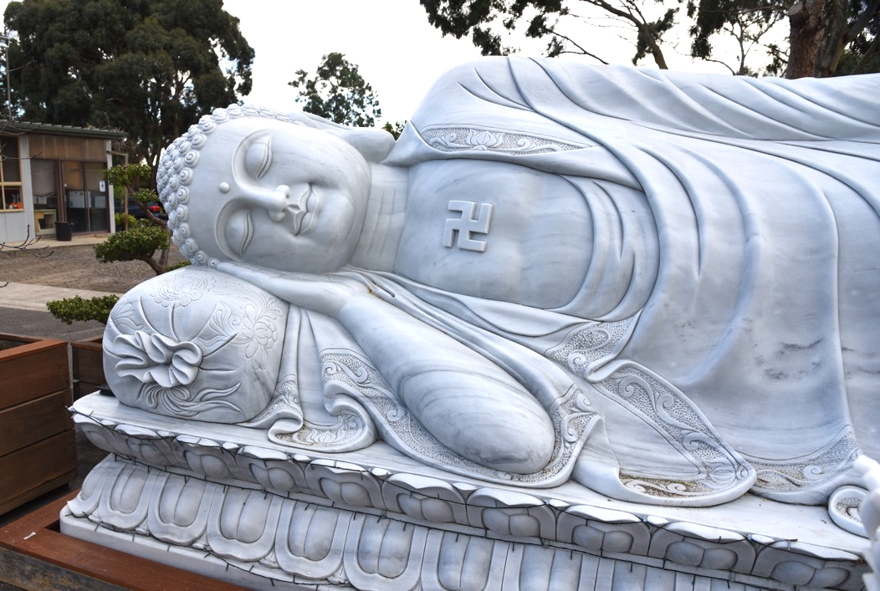
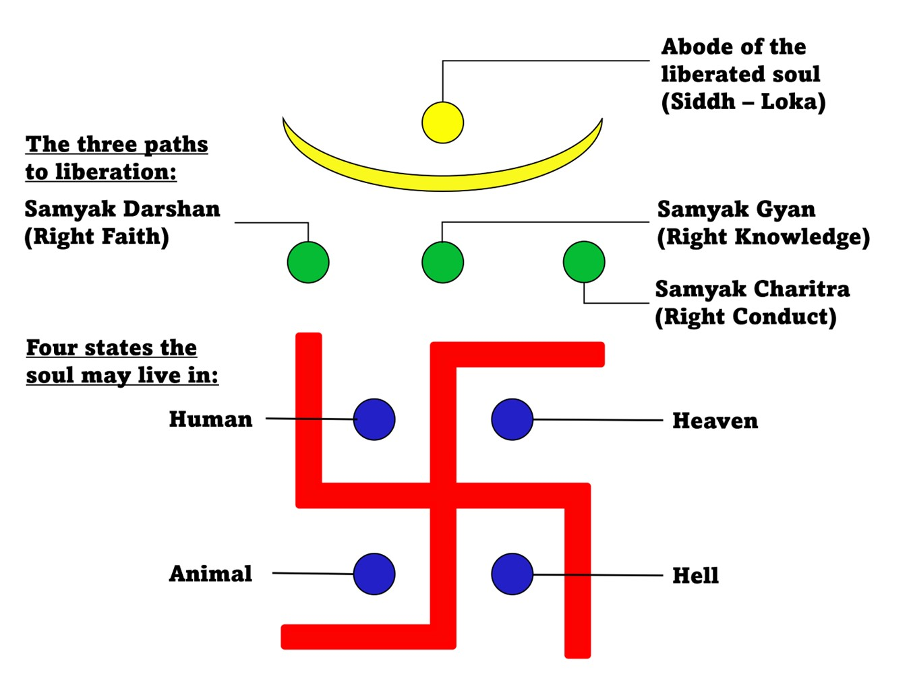




Examples of religious and cultural uses
of the sacred Swastika
There are many variations of the sacred Swastika across and within faith groups.
Some examples are shown here.
Hindu Swastika
Buddhist Swastika
Jain Swastika

Slide 8
How does the law work?
Police can charge a person who is suspected of intentionally displaying a Nazi Hakenkreuz symbol in public, where the display does not fall within one of the exceptions.
A person who is found guilty of the offence could face a fine of up to approximately $22,000 or 120 penalty units, up to 12 months’ imprisonment, or both.
Police can also direct a person to remove a Nazi Hakenkreuz symbol from public view if they reasonably believe the person is committing an offence.
A person who fails to remove the Nazi Hakenkreuz symbol from public view can face a fine of $1,800 or 10 penalty units.

Slide 9
Why was the law created?
The law makes it a criminal offence to publicly display the Nazi Hakenkreuz symbol, the most widely known Nazi symbol. This prevents the symbol being used to harm Jewish and other communities in Victoria.
The Nazi Hakenkreuz symbol represents an ideology that is fundamentally incompatible with Victoria's multicultural, multi-faith and democratic society. Displaying the symbol can be harmful, which is why it was banned.
The purpose of the law is not to ban the use of the sacred Swastika for genuine cultural or religious purposes by the Hindu, Buddhist, Jain, and other faith communities.

Slide 10
Will police approach me if I display the
sacred Swastika?
Police can speak with members of the community for the purpose of confirming the display is for genuine religious and cultural use, which is permitted by the new law.
Victoria Police has developed guidance for its members regarding the new law. This guidance highlights that the new offences are only intended to apply to displays associated with the Nazi ideology.
If Victoria Police receive a complaint that someone might be breaking the law, they may investigate and speak to the person who has been reported for displaying the Nazi Hakenkreuz symbol.

Slide 11
How do I report a display of the Nazi
Hakenkreuz symbol?
If you want to report a display of the Nazi Hakenkreuz symbol to police, you can:
Call the Police Assistance Line on 131 444
Report online via Police Assistance Line and Online Reporting (www.police.vic.gov.au/police-assistance-line-and-online-reporting)
Call Crime Stoppers on 1800 333 000, or
Contact your local police station.
If it is an emergency, please call Triple Zero (000).

Slide 12
Who can give me legal advice about
displaying the sacred Swastika?
You can get advice or find a lawyer through the services listed below.
Victoria Legal Aid provides free legal advice to individuals on a range of matters. Visit the Victoria Legal Aid website (www.legalaid.vic.gov.au/contact-us) or call on 1300 792 387 (Monday to Friday 8.00 AM – 6.00 PM). Phone help is available in languages other than English – visit Speak us in your language (www.legalaid.vic.gov.au/speak-us-your-language) to find out more.
The Law Institute of Victoria (LIV) Legal Referral Service can help you find the right lawyer. Visit Find Your Lawyer Referral Service (www.liv.asn.au/Web/Content/For_the_Public/Referral/Referral_Search.aspx) online or call 9607 9550 (Monday to Friday 9.00 AM – 5.00 PM)

Slide 13
Where can I find more information?
Learn more about the legislation below:
Victorian Government fact sheet (www.vic.gov.au/fact-sheet-nazi-symbol-prohibition)
Summary Offences Amendment (Nazi Symbol Prohibition) Act 2022 (www.legislation.vic.gov.au/as-made/acts/summary-offences-amendment-nazi-symbol-prohibition-act-2022)
Second Reading Speech (https://tinyurl.com/bdvayfb9)

