Slide 1
Investing in Women Grassroots Grant Program Applicant Information Session
OFFICIAL

Slide 2

Overview of todays session
Key dates and assessment process
Program aims and priorities
Eligibility
Assessment Criteria
Online grants portal
Q & A

Slide 3
Key dates
Date | Activity
Monday, 24 April 2023 | Applications Open
Monday, 22 May 2023 at 3:00pm | Applications Close
May-June 2023 | Assessment, approvals, notification and contract establishment
30 June – 31 March 2024 | Grant activities to be delivered All grant funds to be fully expended
31 March 2024 | Final reports due

Slide 4
Assessment process
Stage 1:
Initial Assessment
Stage 2:
Panel Review
Stage 3:
Ministerial Approval

Slide 5





What are the program aims?
Cultural Change: Victoria is free from gender stereotypes, gender roles and prejudices
Health and Wellbeing: The health and wellbeing of Victorians is not limited by gender
Safety and Respect: All Victorians are safe and treated with respect
Economic and Material Security: Victorians have equal access to economic and material security

Slide 6


Overarching considerations
Whole of life: Support for women at all stages of their lives
Intersectionality: Many women experience overlapping forms of discrimination or disadvantage

Slide 7
Who can apply?
You must be either:
An organisation incorporated under the Associations Incorporation Reform Act 2012, Corporations Act 2001 (Cth) or equivalent law; or
A company incorporated under the Corporations Act 2001 and registered as not-for-profit through the Australian Charities and Not-for-profits Commission (ACNC)
You must have:
A current Australian Business Number (ABN)
At least $10million in public liability insurance
No outstanding final reports from other departmental grants

Slide 8
Who cannot apply?
The following entities are not eligible to apply for these grants
State and Federal Government Departments and agencies
Commercial Enterprises
Local Government Authorities
Registered primary and secondary schools, preschools and universities
Applicants with overdue or outstanding final reports with DFFH
Applicants based outside of Victoria

Slide 9
Auspice arrangements
Consider using an auspice if your organisation is not eligible
An auspice organisation must meet eligibility criteria, have a current ABN and appropriate Public Liability insurance
A support letter must be provided with application

Slide 10
Assessment criteria
Program Objectives (25%)
Project Delivery (25%)
Project Outcomes (25%)
Project Impact (25%)

Slide 11

What will be funded?
Partnering with organisations, community leaders or sporting clubs to promote gender equality and collaborate on initiatives in community settings
Development of initiatives that educate, improve access and reduce stigma around women’s health issues
Deliver community-led initiatives that educate the broader community on safe and respectful relationships
Mentoring programs, upskilling workshops or development of initiatives to support women’s leadership and progression

Slide 12

What will not be funded
Activities not aligned with program principles and objectives
Research activities
Commercial or fundraising activities
Promotion of political views or activities held for politically partisan purposes
Activities taking place outside of Victoria
Retrospective funding for projects or programs that have already started
Salaries for staff
Buying alcohol
Building works
Interstate and international travel
Items not clearly described or labelled ‘miscellaneous’ in application

Slide 13
Tips for writing a strong application
Have a clear understanding of your project before starting
Read (and re-read) the program guidelines
Engage your stakeholders
Make your application easy to read
Propose realistic plans
Include in-kind support in your budget

Slide 14
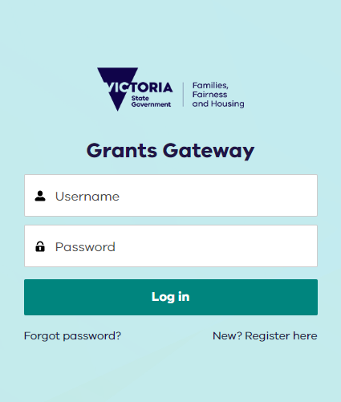
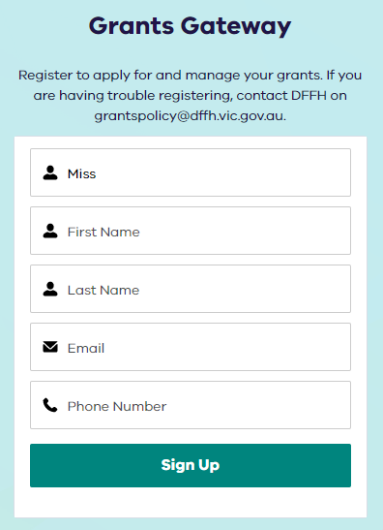
Online Grant Portal
Step 2:
Enter Title
Step 3:
Enter First Name
Step 4:
Enter Last Name
Step 5:
Enter Email
Step 6:
Enter Phone Number
Step 1:
Click New? Register Here
Step 7:
Click Sign Up

Slide 15
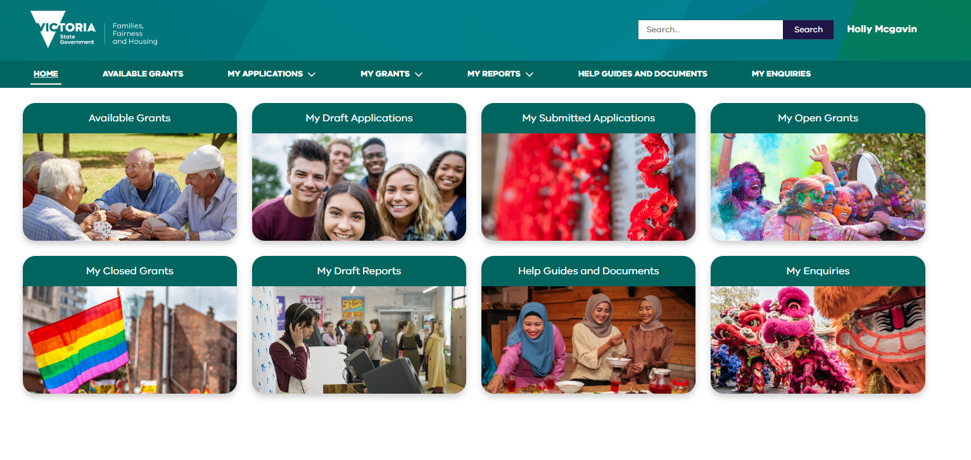
Online Grants Portal
Available Grants
List of all grants available at DFFH
Submitted Applications
Once you have submitted an application you can view it here with any attachments.
Draft Applications
If you have started and saved an application, please return here. Do not create a new application
My Open Grants
You will be able to view any of your current and active grants with DFFH here.
My Draft Reports
If you have started and saved online progress or final report it will be visible here until you submit.
Help Guides and Documents
You can find help guides and documents to assist in navigating the gateway
Closed Grants
Previously completed grants will be available here
My Enquiries
From here you can email us directly, your enquiry will be recorded and monitored and actioned.

Slide 16

Questions

Slide 17
Additional Resources
If you have further questions, or need help with your application, you can:
Email: Women.Victoria@dffh.vic.gov.au
Access: User Help Guides on the Grants Gateway (www.grantsgateway.vic.gov.au)
Download: The grant program guidelines from the Investing in Women Grassroots Program website (www.vic.gov.au/investing-in-women-grassroots-grant-program)

Slide 18
Accessibility statement and publisher information
To receive this presentation in another format email the Office for Women <women.victoria@dffh.vic.gov.au>.
Authorised and published by the Victorian Government, 1 Treasury Place, Melbourne.
© State of Victoria, Australia, Department of Families, Fairness and Housing, May, 2023
With the exception of any images, photographs or branding (including, but not limited to the Victorian Coat of Arms, the Victorian Government logo or the Department of Families, Fairness and Housing logo), this work is licensed under a Creative Commons Attribution 4.0 licence.
The terms and conditions of this licence, including disclaimer of warranties and limitation of liability are available at Creative Commons Attribution 4.0 International Public License <https://creativecommons.org/licenses/by/4.0/>.
In this presentation, ‘Aboriginal’ refers to both Aboriginal and Torres Strait Islander people. ‘Indigenous’ or ‘Koori/Koorie’ is retained when part of the title of a report, program or quotation.
ISBN/ISSN 978-1-76130-130-8 (online/PDF/Word)
Available at Investing in Women’s Grassroots Grants Program <https://www.vic.gov.au/investing-women-grassroots-grant-program>

