Slide 1
Flexible Local Transport Solutions Program
  (FLTSP)

Slide 2
Flexible Local Transport Solution Program (FLTSP) – Overview
  The Flexible Local Transport Solutions Program (FLTSP) is a Victorian Government initiative that enables local government and community organisations to partner with the Department of Transport and Planning (DTP) on local transport reform and investment.
  Funding is available for organisations to collaborate with the Victorian Government in response to a local transport need, particularly where other local transport solutions do not exist.
  The program is managed by DTP, which works with regional stakeholders, local councils and community organisations to identify and deliver reform opportunities and innovative local transport solutions.
  Since 2017, over 100 initiatives with over $7 million in program funding have been brokered by councils, transport providers and community organisations in partnership with the Victorian Government.

Slide 3
Flexible Local Transport Solution Program (FLTSP) – Overview
  FLTSP supports projects across Victoria that helps address transport disadvantage, demonstrates feasibility and value for money, contributes to an integrated transport network and which also:
    Drives reform and innovation in the transport sector at a local level;
    Promotes active transport and/or transport safety;
    Promotes inclusion to help address transport disadvantage and improve connectivity; and
    Progresses transport planning at a local level.

Slide 4
The Program
    The Program:
    Delivers small capital projects that contribute to an integrated transport network by improving safety, access and connectivity – including for active transport
      E.g., missing link pathways, wayfinding signage, crossings and bike hubs.
    Supports transport planning at a local level to help inform future needs, deliver innovative transport solutions and facilitate investment
      E.g., evidence-based transport network plans, freight studies, transport audits and station masterplans.
    Drives reform and innovation in the delivery of transport services
      E.g., online booking portals, demand responsive service trials and volunteer management systems and portals.
    Promotes inclusion in remote, disadvantaged and Aboriginal Victorian communities by facilitating transport options that connect them to local businesses, employment, amenities, essential services and education
      E.g., community buses and transport services trials
    Recognises, respect and celebrate Aboriginal culture and heritage through local transport projects developed in partnership with Victorian Traditional Owners
      E.g., interpretative, Acknowledgement and Welcome to Country signage, artwork and sculptures on walking trails and pathways

Slide 5
Projects driving reform and innovation
    FLTSP is trialling innovative approaches to Mobility as a Service, using technology, demand responsive models and more flexible use of transport assets owned by the State, local government and not-for-profit organisations.
    The Program also supports the intent of Victoria’s Commercial Passenger Vehicle Industry Act 2017, which came into effect in July 2018.
      This legislation – for the first time – allows organisations such as Councils that own coaches, mini-buses and other transport assets to charge a fee to residents to use these services.

Slide 6
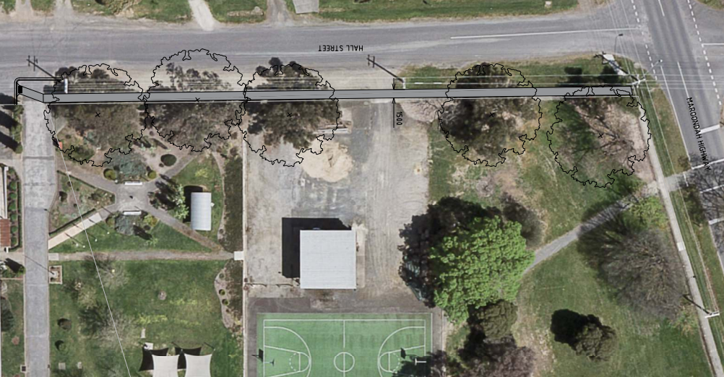
Delivering small capital works
Case study: Alexandra Pathway Connections Project – Murrindindi Shire Council (Hume)
    FLTSP contributed towards a project to improve connections between existing pathways in the township of Alexandra by improving access to walking and cycling infrastructure to strengthen community connectivity and liveability.
    The project supports improved and safer connections along Hall Street for Alexandra Secondary College students and residents from the southern area of the township.
    The initiative involved the construction of a pedestrian link along Hall Street, Alexandra, between Downey Street, Nihil Street and Cooper Street connecting three existing footpaths.

Slide 7
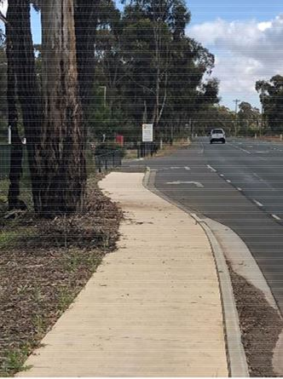
Delivering small capital works
Case study – Missing footpath link, Bendigo & District Aboriginal Co-operative, Prouses Road - City of Greater Bendigo (Loddon Mallee)
FLTSP supported a project to construct a missing footpath link along Prouses Road in Bendigo in partnership with the City of Greater Bendigo.
The missing footpath, located adjacent to the Bendigo & Districts Aboriginal Corporation (including an integrated day care centre), enables safe access to BDAC by the Aboriginal Victorian community, enhancing health outcomes and community participation.
Creating the link also improves access to bus services previously inaccessible to the broader Bendigo community without walking along a major road, and also creates more active transport options including walking and cycling.
Council engaged with BDAC throughout the project, with both Council and BDAC promoting the project to people accessing community services and public transport.

Slide 8
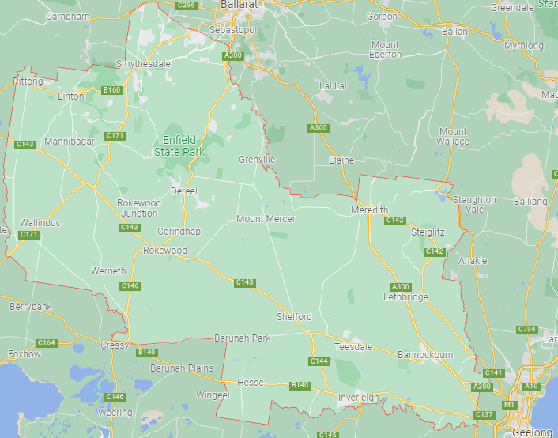
Progressing local planning
Case study: Golden Plains Community Transport Services Audit –
Golden Plains Shire Council (Grampians)
    With funding support from FLTSP, Golden Plains Shire has undertaken a comprehensive study of local and public transport connections within the Shire, creating an evidence base to support future investment in transport.
    The study benchmarked transport services and identified gaps, opportunities, challenges and community transport needs within the Shire.
    As the municipality consists of many small townships, ensuring good transport connectivity to health, education, employment and other amenities that can be delivered in an efficient manner, will help improve the liveability and sustainability of these smaller communities and support the wellbeing of the residents.
    The project is now complete, with the Shire now focussed on implementation of the recommendations.

Slide 9
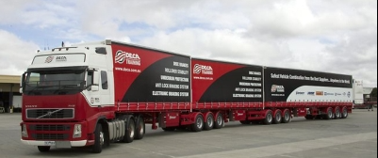
Progressing local planning
Case study: Freight Road Network Mapping and Infrastructure Investment Prospectus Pilot (Central Murray)
    FLTSP funding towards a project for Swan Hill and Gannawarra Shire Councils to identify local road infrastructure limitations which are constraining the use of High-Performance Freight Vehicles (HPFVs).
    The project has generated a prioritised infrastructure investment and action plan to address HPFV limitations as a strong evidence base for funding proposals. This includes close 150 km of road infrastructure, 17 culverts and 11 bridges for upgrading.
    The project outcomes and methodology (particularly the use of heavy vehicle telematics data) will be shared with other regions in Victoria.
    This project is complete, with the Councils now considering the findings and next steps.

Slide 10
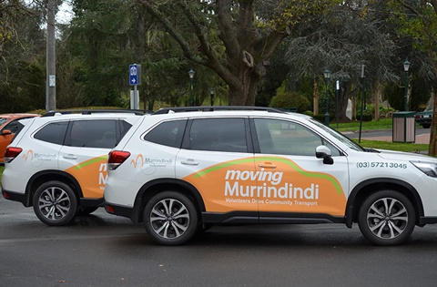
Driving reform and innovation
Case study: One Network project – Community Accessibility (Hume)
    Supported by FLTSP, Community Accessibility worked with the CSIRO to develop technology to manage a fleet of community vehicles enabling them to be securely booked and equipped with routing equipment.
    Murrindindi Shire Council are utilising the technology developed within their own fleet of community vehicles.
    The project provides transport for those who cannot connect to regional centres, health services and the public transport system.
    The new technology includes an SMS functionality to advise clients of approaching transport and inform carers and family of the arrival and departure of transport users.
Notes:
Supported by $300,000 from FLTSP, the project is providing the needed technology to manage a fleet of community vehicles enabling them to be securely booked and equipped with routing equipment.
Community Accessability is working with the CSIRO to develop technology that will be tailored for the unique needs of community transport, encompassing mobility issues and volunteer drivers.
Murrindindi Shire Council will utilise the technology developed within their own fleet of community vehicles. This will ensure a more efficient use of resources that target the transport disadvantaged.
The initiative will enable tailored service to meet the transport needs of the user. Targeting people without the ability to drive or without a vehicle of their own, the project will provide transport for those who cannot connect to regional centres, health services and the public transport system.
Project Benefits
The One Network project will provide greater capacity to respond in a coordinated manner to address the growing demand for community transport in rural and regional towns.
By developing technology that delivers a more efficient fleet management and booking system, Community AccessAbility are positioned to deliver
more flexible local transport solutions.
The new technology will include an SMS functionality to advise clients of approaching transport and inform carers and family of the arrival and departure of transport users.
Targeting connectivity to public transport, health services and other regional centres, One Network aims to fill the transport gaps being experienced by the transport disadvantaged.
The aim is to promote the technology to other community transport groups.

Slide 11
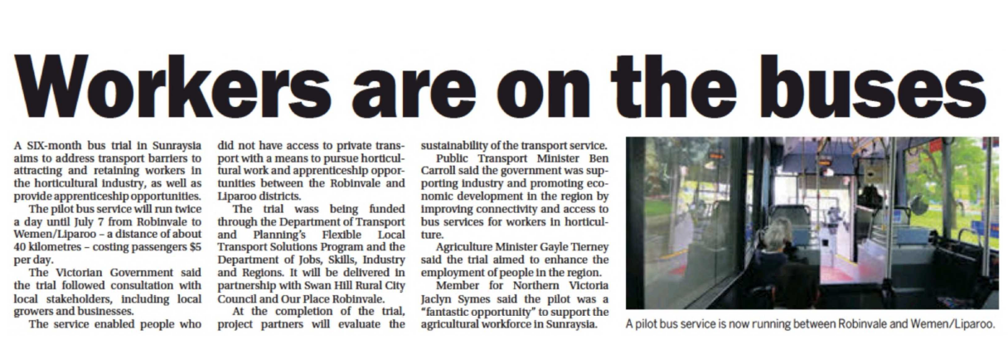
Providing transport connections for remote communities
Case study: Robinvale-Liparoo bus service (Loddon Mallee Region)
  FLTSP supported a six-month bus trial in the Sunraysia region to help address transport barriers to attracting and retaining workers in the horticultural industry and provide apprenticeship opportunities.
  The pilot bus service ran between 9 January to 7 July 2023 from Robinvale to Wemen/Liparoo - a distance of approximately 40km - twice a day. Costs for users is $5 per day.
  It followed consultation with local stakeholders, including local growers and businesses, with the service enabling people who do not have access to private transport with a means to pursue horticultural work and apprenticeship opportunities in the area.
  The trial had 17 employees daily utilising the bus service and works in with the 2 school bus runs between the 2 towns, when the bus would otherwise have been empty on the return trip or been idle.
  The Department of Jobs, Skills, Industry and Regions also supported and was delivered in partnership with Swan Hill Rural City Council and Our Place Robinvale.

Slide 12

Providing transport connections for remote communities
Case study: Loddon Campaspe Student Excursion project – City of Greater Bendigo (Loddon Mallee)
    FLTSP supported City of Greater Bendigo with funding to provide a transport subsidy for rural and regional students to attend educational activities, arts and excursions that are not available in their hometowns and schools.
    The City of Greater Bendigo has successfully been managing the program for three years.
    In 2019, the project funded 51 trips by 36 schools to 33 different educational activities with 2170 students (with teachers) from 3 years to 18 years.
    This transport support program is a key enabler for students to remain engaged and supports regional aspirations to improve education attainment rates and reduce youth unemployment .
    This transport support model inspired a similar initiative to be adopted by Swan Hill Rural City Council and in Gippsland and Ballarat.

Slide 13

Providing transport connections for remote communities
Case study: Transport Solutions for South Gippsland and Bass Coast VET Students (Gippsland)
    Supported AGA Apprenticeships Plus by FLTSP funding to pilot the chartering of a 57-seat bus service to transport their students who live in Bass Coast and South Gippsland to VET programs in Korumburra and Leongatha.
    The service had 12 stops and followed a route from Phillip Island to Leongatha, via Wonthaggi, Inverloch and Korumburra catering for about 60 students in total over the two days per week.
    Students being able to access these VET programs supports education retention and is leading to a greater take up of apprenticeships, allowing students to pursue a trade career of choice.
    The trial showed it is a much more cost-effective delivery model than traditional route timetabled bus services.
    A plan is now in place to support this flexible transport model into the future.
Notes:
$36,000 FLTSP funding for a 57-seat chartered bus service (including driver and insurance) to pilot transport and access for students from Bass Coast and South Gippsland (particularly Phillip Island) to VET programs in Korumburra (AGA Apprenticeships Plus) and Leongatha (Federation Training & CCG (Community College Gippsland) in 2019.
This initiative was largely driven by the closure of the building and construction VET program at Chisolm TAFE in Wonthaggi at the end of 2017. This meant that Bass Coast and South Gippsland students who aspired to pursue a building and construction career path (particularly those from Phillip Island) were limited by their capacity to find transport to AGA (Korumburra).
The service in 2019 had 12 stops and follow a route from Phillip Island to Leongatha, via Wonthaggi, Inverloch and Korumburra catering for about 60 students in total over the two days per week.

Slide 14
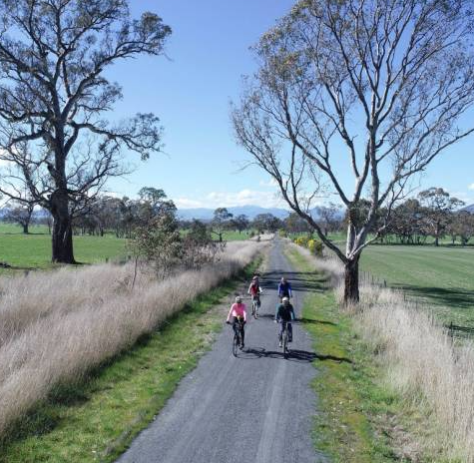
Recognising, respecting and celebrating Aboriginal culture and heritage
Case study: Great Victorian Rail Trail – Taungurung Interpretive Signage Project
Murrindindi Shire Council and TLaWC (Hume)
  FLTSP supported a project to install six interpretive signs along the Great Victorian Rail Trail (GVRT) in partnership with the Taungurung Land and Water Council to recognise the Taungurung people as the Traditional Owners of the land on which the trail exists.
  The project will also increase visitor and community awareness and education of Taungurung history and Taungurung Country.
  The GVRT is a multi-use trail that spans 134 kilometres across the Local Government Areas of Murrindindi, Mitchell and Mansfield shire councils – the longest rail trail in Australia.
  Currently the three Councils are delivering a GVRT Art Installations and Signage Project including an allocation for interpretative and wayfinding signage, which is now fully committed.

