Slide 1

Disaster Recovery Funding Arrangements (DRFA) Preparedness Roadshow
October 2023

Slide 2





What is the DRFA?
The Disaster Recovery Funding Arrangements (DRFA) is a cost sharing arrangement between States/Territories and the Commonwealth.
The DRFA applies to natural disasters or terrorist acts only. Activation thresholds apply.
The arrangements enable the State and Commonwealth to provide financial assistance, to support certain relief and recovery measures following an eligible disaster, they do not cover all costs that may be incurred.
  States are not bound or limited by the assistance measures identified in the DRFA and may make available whatever assistance is deemed necessary regardless of whether it is eligible for reimbursement.
DRFA measures consist of four categories of financial assistance
  Category A: Assistance to individuals
  Category B: Essential public assets (i.e. transport or public infrastructure*)
  Category C: Community recovery
  Category D: Exceptional circumstances
The DRFA is not intended to replace other actions and measures that should be taken to protect assets or prevent disasters, including having insurance coverage where possible.
In Victoria, DRFA assistance measures are funded from the Victorian Natural Disaster Relief Trust administered by Emergency Management Group within DJCS.
OFFICIAL

Slide 3
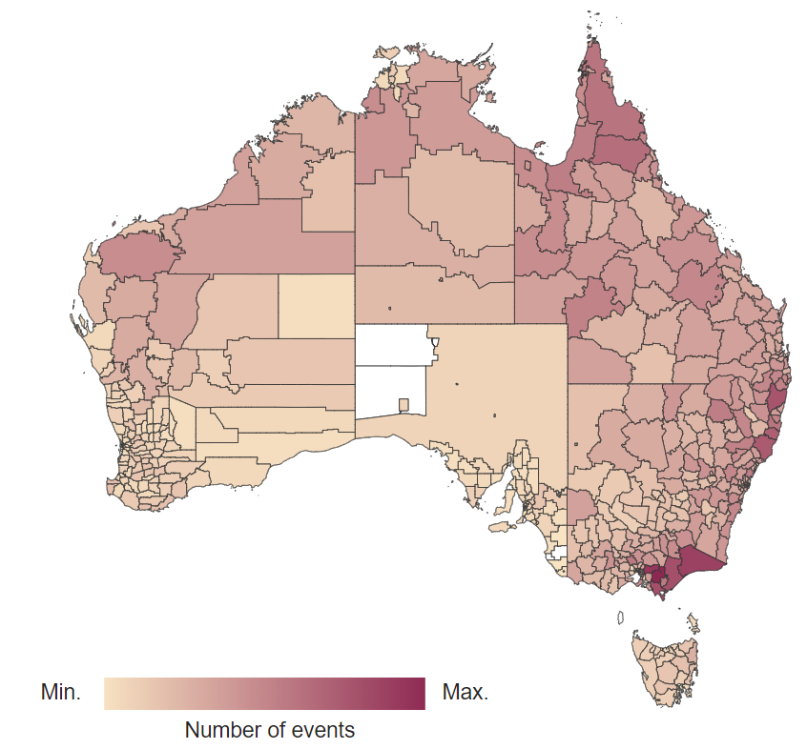


Australian context – cascading, compounding & complex disasters
434 Local Government Areas across Australia
activated
200 disaster events have impacted Australia
> $12.2 billion
in insurance losses
> $3.5 billion
in payments to individuals
> 24,000 homes damaged since 2022
> $15.8 billion national spend on recovery & reconstruction under DRFA
Since 1 January 2019

Slide 4
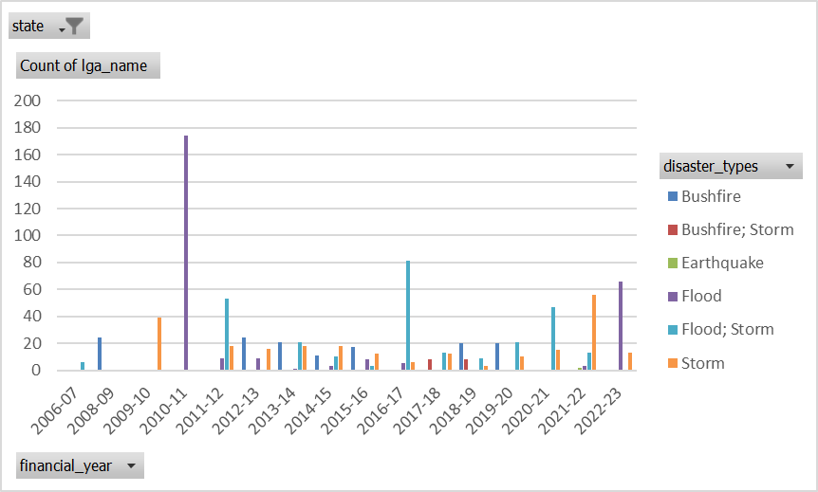
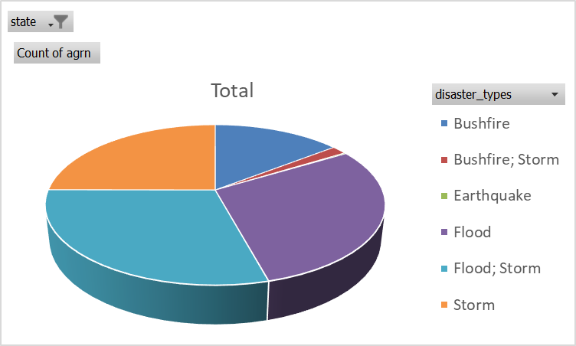
Victorian context- history of AGRNs
DRFA Activation History by LGA - Dataset - data.gov.au
OFFICIAL

Slide 5
DRFA Principles
Recovery is a shared responsibility (between individuals and all levels of government)
Intended to be a helping hand, rather than provide compensation for losses
Does not replace the need for appropriate self-help strategies (e.g. insurance, disaster mitigation)
States should draw on their own resources before seeking Australian Government assistance
Efficient allocation of resources (should provide value-for-money outcomes across all levels of government)
Those affected in the same way by the same disaster should receive the same level of assistance.
OFFICIAL

Slide 6



DRFA ‘standard’ assistance measures
Category A: Assistance to individuals
Category B: Essential public assets (i.e. transport or public infrastructure*)
Early relief and recovery activities including the establishment and operation of a Municipal Emergency Coordination Centre, and/or a Relief and Recovery Centre.
Counter disaster operations undertaken to provide direct assistance to individuals, immediately before, during and in the immediate aftermath of a disaster (e.g. sandbagging or the establishment of bushfire control lines).
Personal hardship assistance programs administered by the Department of Families, Fairness and Housing (DFFH).
Removal of debris operations carried out by councils from residential properties (immediate house footprint only) to make them safe and habitable.
Other - personal and financial counselling and the employment of a Community Recovery Officer.
Category B assistance can be divided into five broad areas of assistance designed to support the community to recover from an eligible disaster:
Emergency works to urgently restore an essential public asset to an acceptable level of service (make safe or temporary repairs) within 3 months from date of the event.
Immediate Reconstruction Works (to fully restore an asset) undertaken within 3 months from date of the event
Reconstruction Works outside of the 3 months window (requires a certified estimate to be prepared).
Counter Disaster Operations for the protection of the general public
Concessional loans to assist impacted small businesses, primary producers and non-profit organisations whose assets have been significantly damaged or who have suffered a significant loss of income as a direct result of an eligible disaster
OFFICIAL

Slide 7


DRFA ‘special’ assistance measures
Category C – Community recovery
Category D – Exceptional circumstances
    Community Recovery Fund – grants/programs to restore social networks, community functioning and community facilities.
    Recovery grants for small businesses and non-profit organisations and primary producers. Aimed at covering the cost of clean-up and reinstatement (not compensation for losses), Grants can vary depending on event – based on recommendation from Agriculture Victoria and Small Business Victoria.
  E.g.: Victorian Bushfires Community Recovery Package, Primary Producer Recovery Grants and Small Business Recovery Grants, Community Recovery Officers.
    Exceptional circumstances assistance that is beyond what can be covered under Categories A, B and C.
    E.g. State Coordinated Clean Up, Infrastructure Betterment
OFFICIAL

Slide 8
Key roles and responsibilities
Natural Disaster Financial Assistance Team,
Emergency Management Group, DJCS
Administration of DRFA; activation of eligible events; Victorian DRFA Guidelines; claims management system; quality assurance review; processing of recommended claims; funding advances, the acquittal on behalf of the Victoria (of all DRFA cost shared programs).
DRFA Assessors, DTP
Lead contact for local council on Category A and B measures
Emergency Recovery Victoria,
Emergency Management, DJCS
State and regional recovery coordination
Lead on Category A and B programs and interaction with the Commonwealth on these categories.
Provide DRFA training to local councils
Assessment of council claims
Lead on Category C and D programs and interaction with the Commonwealth on these two categories.
National Emergency Management Agency
Administration of the DRFA for the Commonwealth; activation of eligible events and measures; advice to Minister/Prime Minister on Category C/D requests; advice to States and Territories on eligibility; consideration of extensions of time; concessional loan management; DRFA claims; reporting (inc. budget, fraud, implementation).
Engagement with States and Territories on DRFA activities.
OFFICIAL

Slide 9
DRFA Lifecycle
Event Notification
Council advise of impact. Events that meet small disaster criterion are submitted to Commonwealth and issued an AGRN
Initial estimates across relevant DRFA categories for the event submitted by impacted councils
Submit Claims
Claims assessed and approved eligible expenditure reimbursed
Dual audit undertaken to determine level of Commonwealth cost sharing with Victoria
Certified estimates for reconstruction works submitted/approved
Submit REPA Claims
Claim assessor assigned
DRFA acquittal prepared at end of each FY
OFFICIAL

Slide 10




DRFA settings- what's changed in Victoria
New Claims Management System (CMS) portal went live on 10 July 2023 capturing entire process from event notification to claim reimbursement. Online training videos and how to guides are available for CMS users. Each council has nominated registered users.
Day labour introduced following the October 2022, councils can now also claim the normal hours salary and wages for staff and Delivery Agency-owned plant and equipment costs that are directly engaged in the delivery of eligible Emergency Works or Immediate Reconstruction Works activities. Plans to expand to REPA in certain circumstances.
Betterment program under Category D was introduced for the first time in Victoria, for the most severely impacted councils from the Oct 2022 flood event. The program leverages current IRW and REPA claim processes and pays for the difference between the category B cost of repairing an impacted asset to pre-disaster function and a more resilient state.
Pre disaster function – clarification on claimable costs under category B relating to repair or reconstruction of a damaged asset to its pre-disaster function.
Victorian DRFA Guidelines and Web site will also undergo an update to support councils to use the new CMS and to increase self-sufficiency in submitting their DRFA claims. A User Reference Group has been established for consultation in the initial design and subsequent development of the DRFA guidelines and website. An interim Toolbox is being established.
OFFICIAL

Slide 11
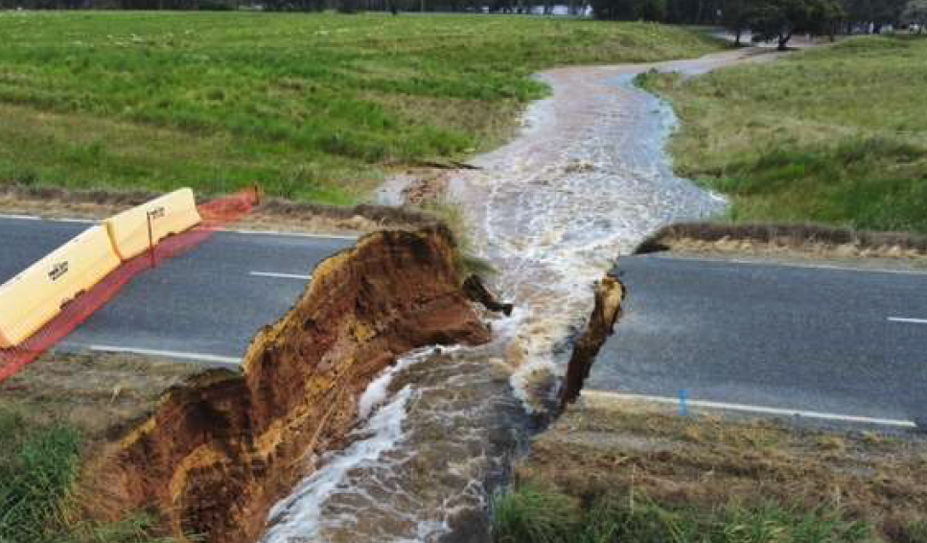



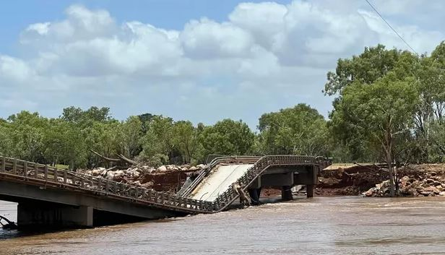

DRFA: Evidentiary Requirements
Key questions for establishing an evidence base
Is the damage event related?
Do we have both pre and post event condition evidence?
Do we have detailed invoices from suppliers?
Is the evidence we are providing linked to essential assets?
Credit: Queensland Reconstruction Authority / Indras
OFFICIAL

Slide 12
DRFA: Evidentiary Requirements
Actual expenditure evidence requirements
The expenditure meets the definition of ‘state expenditure’ under the DRFA 2018, and is claimed in the correct year.
The expenditure relates to the disaster event claimed.
The expenditure relates to the DRFA 2018 measure claimed.
The expenditure meets the relevant eligibility requirements of the measure claimed.
Examples of expenditure evidence
Category A:
Invoices/receipts
Staff/contractor costs
Contract/work orders
Photos and videos
Geospatial data
Email correspondence and meeting minutes
Grant applications and guidelines
Category B:
Photos and videos
Fire/flood mapping
Records of alerts
Road closure report
Asset register
Maintenance records
Loan applications and guidelines
Category C and D:
Funding approval letters
Project completion reports
Governance arrangements
Initiative and activity reports
Category C/D business case
Grant/loan applications and guidelines
Local news/media articles regarding the delivery of initiatives
OFFICIAL

Slide 13

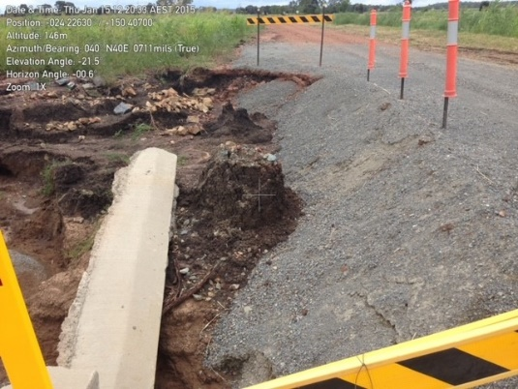
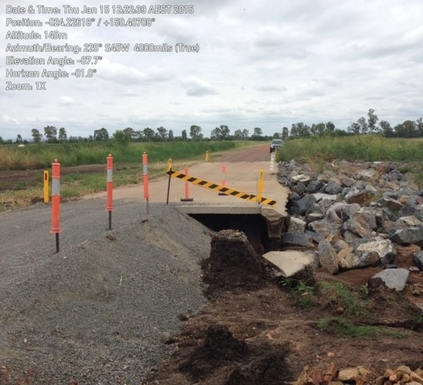

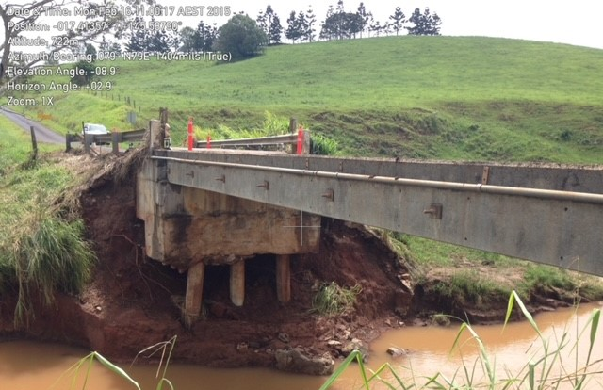


DRFA: Reconstruction of Essential Public Assets (REPA)
Applicant considerations – increase eligibility of REPA assessments by:
Engaging engineering and project management resources with some costs claimed under DRFA
Asset awareness - development and update of Asset Management Systems
Long term Strategy for Asset Management and Maintenance Records
Digital Photo-runs (Go-pro/Navman/Garmin or similar) that are GPS enabled
Credit: Queensland Reconstruction Authority / Indras
OFFICIAL

Slide 14
Scenario 1
Situation
Council has been impacted by a significant fire event, 50 homes in the town have been forced to evacuate, including an aged care centre, and the residents are not able to return home.
Access points in/out of the town is restricted due to road closures and the building that is normally set up as a relief centre is not available.
Council has access to a basketball recreation centre to set up as a relief centre with limited kitchen and only three toilets and one shower.
Council has limited staff available for the relief centre operations and Council has requested staff from neighbouring councils to assist.
Questions
What expenditure is eligible?
What expenditure is not eligible?
What type of evidence would be required to support the claim?
OFFICIAL

Slide 15



Scenario 1
Relief centres
Examples of eligible costs:
'Additional' staffing costs such as overtime, additional allowances and backfilling
Staff from another council – subject to specific conditions
Hiring portable showers/toilets
Hiring of basketball recreation centre (non council building) and power costs
Hiring of portable generators and provision of fuel to run generators.
Communication costs about the evacuation centre
Transportation for individuals to the centre/emergency accommodation
Provision of emergency accommodation/shelter or through a temporary provider such as a hotel
Essential catering
Essential medical supplies and medication
Costs related to the evacuation of residents from the residential aged care facilities.
Additional costs related to emergency food or essential supply drops to affected communities
Evacuation and housing of companion animals and pets including provision of food and shelter
Examples of ineligible costs:
Cost recovered from other sources
Standby costs for council staff
Cost that would have been incurred should the event not have occurred.
Internal hire charges
Capital purchases including generators, computers, phone
Live stock assistance such as fodder dropping operations,
Cost associated with general community BBQ for debriefs which are held after the event and not associated with the operation of a relief centre.
Evidence requirements
Evidence costs directly linked to the activity
Detailed general ledger or transaction report
Payroll reports for extraordinary payroll costs
Resources required (eg staff and roles, and when backfilling the reason and details of the officer being backfilled)
Tax invoices for external expenditure
OFFICIAL

Slide 16
Scenario 2
Situation
Early flood warnings are showing that the peak of the flood will impact a number of homes in your town.
In discussion with the Incident Controller Council decides to establish a temporary flood levee to prevent inundation of residential properties.
Questions
What expenditure is eligible?
What expenditure is not eligible?
What type of evidence would be required to support the claim?
OFFICIAL

Slide 17
Scenario 2
Examples of eligible costs:
Extraordinary costs of sandbagging and the construction of portable temporary levees/flood barriers.
Extraordinary costs of removing the sandbagging/portable temporary levees/flood barriers
Costs of restoring assets directly damaged during the construction of the portable levee works
Examples of ineligible costs:
Cost recovered from other sources
Cost that would have been incurred should the event not have occurred.
Internal hire charges
Capital purchases
Day Labour
Decommissioning costs outside allowable time periods
Evidence requirements
Details of the location of the sandbagging/levee overlaid by the flood warning area/Incident Control approval
Detailed general ledger or transaction report
Payroll reports for extraordinary payroll costs
Tax invoices for external expenditure
Pre-condition evidence where claiming costs of assets directly damaged during the CDO works
OFFICIAL

Slide 18
Scenario 3
Situation
Following a bushfire event, a significant number of damaged trees are across the roadside reserve (or are at danger of falling) in park reserves and in neighbouring residential areas.
Questions
What expenditure is eligible?
What expenditure is not eligible?
What type of evidence would be required to support the claim?
OFFICIAL

Slide 19
Scenario 3
Examples of eligible costs:
Removal of disaster related debris across the immediate road envelope area/immediate residential footprint.
Removal of damaged /dangerous trees impacting on the council road or residential block to make them safe and functional
Transportation and disposal of the disaster related debris
Establishment of temporary dump sites for disposing of disaster related debris (includes establishment, operation, and decommissioning costs),
Erection of warning signs or barriers to ensure the asset can be safely used for its intended purpose
Installation of temporary traffic management.
Eligible Day Labour
Examples of ineligible items
Removal of trees outside the immediate road envelope area or immediate residential footprint.
Removal of debris from ineligible assets including community assets, parks, cemeteries, fire access trails and commercial properties.
Works undertaken outside of the allowable time period.
Ongoing council maintenance activities (tree pruning)
Evidence requirements
Evidence demonstrating the impact to the eligible essential public asset . Evidence must be collected after the event and while undertaking the emergency works (visual data).
Evidence costs directly linked to the activity
Detailed general ledger or transaction report
Tax invoices for external expenditure
OFFICIAL

Slide 20
Scenario 4
Situation
Following a fire event, connectivity infrastructure has been damaged including cracks, deformations and landslides to various roads/pavements/safety rails/tracks across the local government area.
Questions
What expenditure is eligible?
What expenditure is not eligible?
What type of evidence would be required to support the claim?
OFFICIAL

Slide 21
Scenario 4
Examples of costs:
Costs of road resurfacing, restoring damaged retaining walls structures, guard rails, burnt culverts to its pre-disaster function.
Eligible Day Labour
Examples of ineligible items
Fire trails
Pedestrian and cycle paths that are not considered to be transport infrastructure.
Roads in parks and reserves
Roads not owned by councils
Works undertaken above the pre disaster function.
Works undertaken outside the allowable time period ( 3 months for Immediate Reconstruction Works)
Evidence requirements
Details of the location, nature and extent of the damage
The date ranges of works undertaken
Pre event and post event evidence
Post completion photographic evidence
Detailed general ledger or transaction report
Tax invoices for external expenditure

Slide 22
DRFA: Category B and Category D (Betterment)
Category B
  Flexibility within Category B to support the reconstruction of more resilient infrastructure.
  A state can claim the estimated cost (i.e. the Estimated Reconstruction Cost) of restoring a damaged essential public asset to its ‘pre-disaster function”.
    Pre-disaster function can be determined through several means included legislation, standards or assessment by a ‘suitably qualified professional’ (i.e. engineer or quantity surveyor) where approved by the state.
  Actual reconstruction can include adopting an alternative value-for-money solutions where it is within the Estimated Reconstruction Cost.
Category D
  Restoration or replacement of a damaged essential public asset to a more disaster resilient standard than its pre‑disaster standard (i.e. beyond what is claimable under Category B).
  Prime Minister has agreed to Betterment funding under Category D in NSW, QLD and Victoria.
  DRFA Review developing new national guidance explaining how Category B and Category D can be used to help generate greater investment in disaster resilient infrastructure.
OFFICIAL

Slide 23

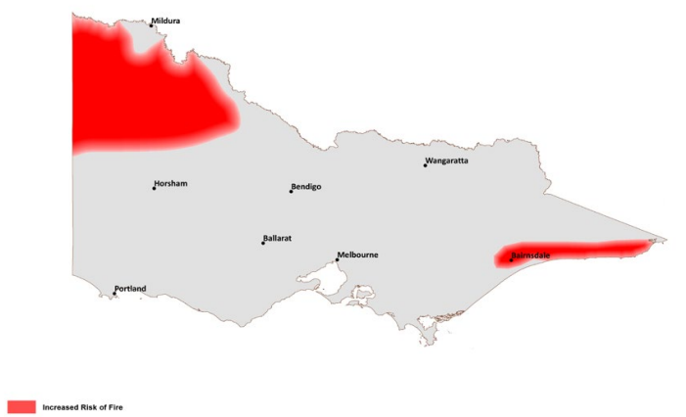
Australian seasonal bushfire outlook
September–November 2023
Victoria can expect a warmer spring and earlier start to the high risk fire season this year, following three years of lower fire risk seasons as a result of La Niña conditions.
In East Gippsland and Central Gippsland there is a higher than normal potential for forests to carry fire in the outlook period, especially in and surrounding coastal communities close to bushland where vegetation was unburnt or lightly burnt during the 2019-20 fires.
there is a high likelihood that the bushfire season of 2023-24 will commence earlier across much of central, western and northern Victoria. In agricultural areas, elevated grass fuel loads will likely cure earlier than most years and may present an elevated risk until harvest occurs.
Fire is a regular occurrence across Australia. Destructive and deadly fires can still occur during normal bushfire seasons.
The summer outlook will be released at the end of November.
Increased fire risk
OFFICIAL

Slide 24




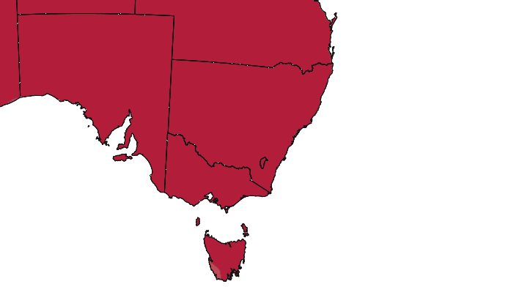
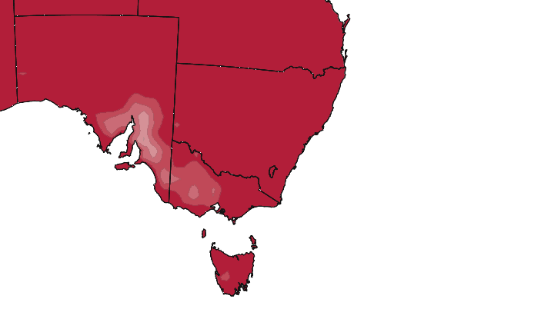
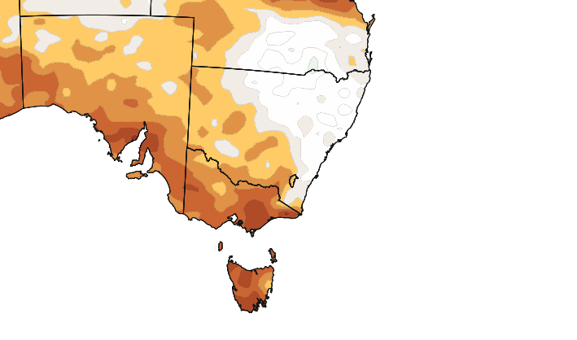
October – December 2023 long-range forecast
Chance of above median
Maximum temperature | Minimum temperature | Rainfall
Reference period
1981-2018
OFFICIAL
Notes:
Model Run: 21 Aug 23
Climate reference period: 1981–2018
Outlook maps: Updated Between Weds pm - Thurs pm
LINKED = AUTO
http://cmap.bom.gov.au/sco/access_plots/plots_clean/tmax.forecast.median.national.season2.ncwb.png
http://cmap.bom.gov.au/sco/access_plots/plots_clean/tmin.forecast.median.national.season2.ncwb.png
http://cmap.bom.gov.au/sco/access_plots/plots_clean/rain.forecast.median.national.season2.ncwb.png
Skill maps
Linked = AUTO
http://cmap/sco/access_plots/wpc-clean/tmax.skill.wpc.median.seasonal.inixx.lt2.xx.aus.ncwb.png
http://cmap/sco/access_plots/wpc-clean/tmin.skill.wpc.median.seasonal.inixx.lt2.xx.aus.ncwb.png
http://cmap/sco/access_plots/wpc-clean/rain.skill.wpc.median.seasonal.inixx.lt2.xx.aus.ncwb.png
Title & Text
MANUALLY updated
Title: WEEKLY (Wednesday afternoon) – check it is season1, careful if updating with model run on the first of the month, the first month of season1 is still current month for that run date.
Text: WEEKLY (Wednesday afternoon)
Reviewing
http://cmap.bom.gov.au/sco/outlook-maps-repos.shtml
http://cmap/outlook-maps.shtml
Skill maps 'preview': Australian climate outlook past accuracy maps (bom.gov.au)
A quick way to review if maps are correct is to use the backgrounder montage e.g. http://cmap.bom.gov.au/sco/presentation-graphics/montage/map.montage.YYYYMMDD.png, use model date
Instructions to create if not present - https://bom365.sharepoint.com/sites/OperationalClimateServices/SitePages/Climate-backgrounders.aspx
Source
http://cmap.bom.gov.au/sco/access_plots/plots_clean/
http://cmap/sco/access_plots/wpc-clean/
http://cmap/outlook-maps.shtml
Layout

Slide 25
Hints to be DRFA ‘ready’
In preparation for HRWS season, councils should ensure they are ready to submit claims for funding under the DRFA. The below are some key preparedness items councils should consider.
Useful tips/ resources
Council can request additional users by completing and uploading a signed copy of the CEO or Senior Executive user registration form in the CMS.
Alternatively, can request access via an email to NDFAuser@justice.vic.gov.au (External link) with a signed copy of the CEO or Senior Executive approval form.
Upon logging into the CMS, navigate to the Home page and click on the ‘User Guides’ tile. Click on the folder labelled ‘Help Guides’.
  Claims Management System
  Does council have users with appropriate registered and access to the CMS?
  Are users suitably trained/confident using the system?
DRFA familiarisation
Do you have appointed officer(s) who have read and are familiar the DRFA guidelines?
Do you know who your DTP Assessor is? Every Council has an assigned Assessor available to provide guidance throughout the claims journey.
Has council run a DRFA training session with key staff.
Useful tips/ resources
Disaster Recovery Funding Arrangements (DRFA) - claims | Emergency Management Victoria (emv.vic.gov.au) provides step by-step-process, with supporting guidelines, forms and fact sheets.
Resources
Does council have the resources to build, lodge and manage claims?
If the need for contractors is anticipated, are they on a panel of providers that can be engaged at short notice?
Useful tips/ resources
Where Councils are unable to effectively respond to an event within BAU internal staffing, additional resourcing costs, related to categories A/B measures are able to be claimed.
This may include staff overtime and/or additional temporary employees. Check with your assessor.
OFFICIAL

Slide 26
Hints to be DRFA ‘ready’
In preparation for HRWS season, councils should ensure they are ready to submit claims for funding under the DRFA. The below are some key preparedness items councils should consider.
Data capture
Does council have software/hardware and procedures in place to capture damage data?
How does council collate and store photos?
Who undertakes immediate works- how do they ensure evidence is captured before undertaking the work?
Who captures evidence (prior to, during and at completion of works)?
What pre-condition information does council hold, has this been checked for pre-existing damage?
Useful tips/ resources
Photo Reports are to be submitted in the requested photo report format. All photo are required to have Metadata embedded that verifies location and date taken.
Pre-condition and post disaster photos are to be taken in the same location. If pre-condition photos are not available, a pre-condition report based on maintenance and inspections records can be provided as an alternative and need to be dated no more than four years prior to the disaster occurring.
Where Council engages contractors/in-house crews to undertake works, council should provide them with clear instructions on the relevant supporting information to collect (Factsheets 1 & 3 available Disaster Recovery Funding Arrangements (DRFA) - claims | Emergency Management Victoria (emv.vic.gov.au) ).
Account / Expense reporting
How are costs captured?
Are cost codes (i.e. job numbers) in line with DRFA standard activities?:
Example:
  For CDO- can council identify the different activities undertaken and link the associated expenditure to it?
  For REPA: does council accounting system track costs by activity and can a list of assets for each activity be provided?
Useful tips/ resources
Ensure documentation for example, invoices and the general ledger provide information about the activities undertaken and clearly link back to the event.
OFFICIAL

Slide 27

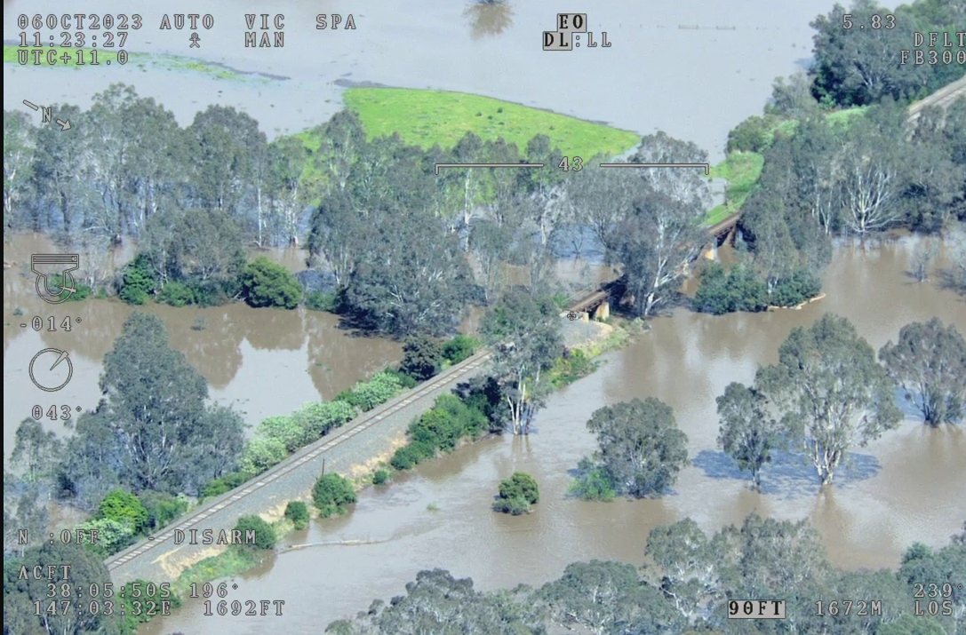
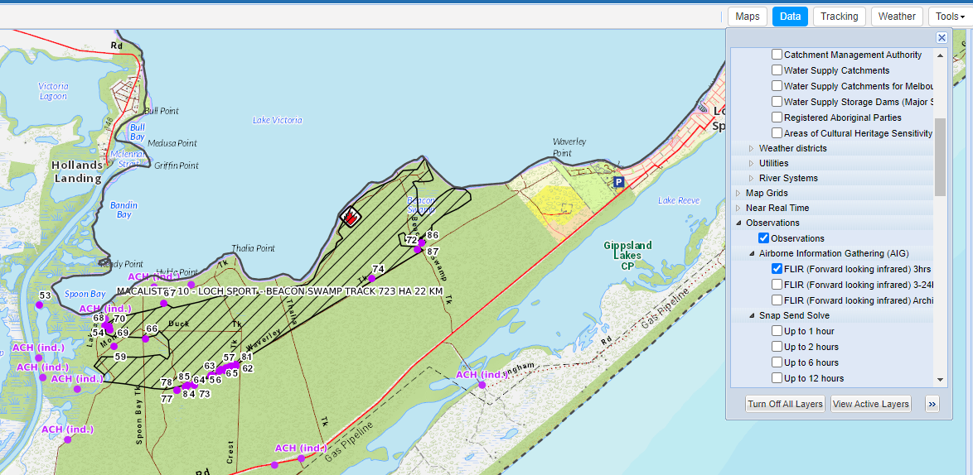
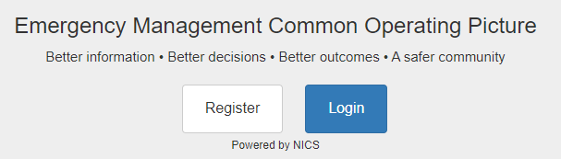
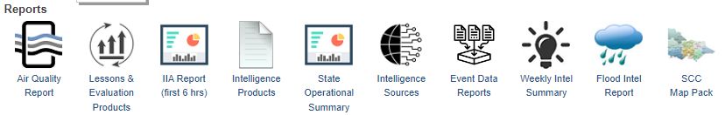
Hints to be DRFA ‘ready’
Familiarise yourself with the suite of state information resources available eg on EM-COP
Maps on situation page for evidence of damage extent
Reports on desktop
https://cop.em.vic.gov.au/sadisplay/main.seam

Slide 28




Hints to assist with ‘timely’ assessment of claims
We need councils help to ensure that the claims assessment process runs as smoothly as it can.
This can include:
Devote appropriate resources to the claims task. It’s a small investment to make relative to value of claims lodged
Use the correct claim form for the category of expenditure being claimed, group similar expenditure together, exclude GST and reconcile to the supporting information provided. Claims need to be structured so that it is easy to follow and understand by a third party reviewing the transactions.
DRFA does not cover all costs, exclude any ineligible expenditure from your claim. Don’t capture ‘everything’ and then rely on the assessor to identify what is eligible and ineligible under the DRFA. If you are unsure after reading the guidelines, discuss this with your assessor.
Lodge claims in the CMS throughout the year as expenditure is incurred, this avoids claim lodgement 'spikes' and also represents sound financial management practice from councils not waiting until the end of the financial year. Claims need to be lodged in the financial year that the expenditure was incurred (no later than 31 July unless an extension of time is provided).
Provide timely response to assessor queries. If no response is provided within the reasonable time, assessor will need to complete the claim assessment on the information provided.
OFFICIAL

Slide 29

Questions??

