Slide 1
Training on the Subordinate Legislation Act 1994 and its Guidelines
Created by Better Regulation Victoria, Office of the Chief Parliamentary Counsel, Scrutiny of Acts and Regulations Committee and the Department of Premier and Cabinet’s Office of the General Counsel.
2025

Slide 2
The SLA
The Subordinate Legislation Act 1994 (SLA) governs the preparation and making of statutory rules and legislative instruments in Victoria.
Importantly, the SLA imposes requirements on the preparation and making of such instruments.

Slide 3
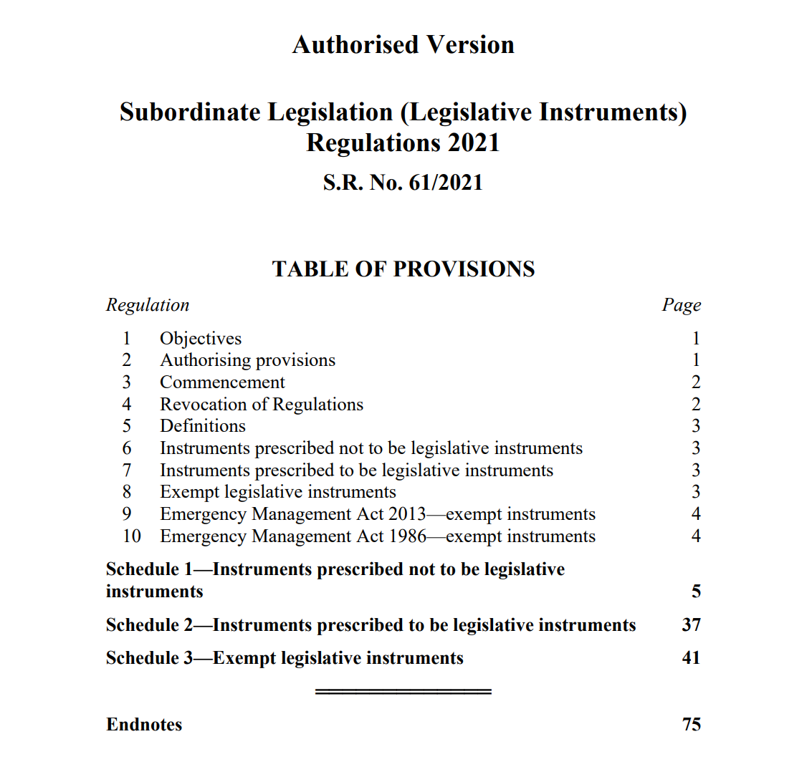
The Regulations
The Subordinate Legislation (Legislative Instruments) Regulations 2021 (Regulations):
Prescribe instruments which are not legislative instruments (so are not subject to the SLA’s requirements) in Schedule 1;
Prescribe instruments as legislative instruments (so are subject to the SLA’s requirements) in Schedule 2;
Exempt certain legislative instruments from most of the SLA’s requirements (other than Government Gazettal publication) in Schedule 3; and
Exempt certain legislative instruments from all the SLA’s requirements (e.g. regulation 8).

Slide 4
The SLA Guidelines
The SLA Guidelines are made under the SLA to assist in:
The preparation, content, publication and availability of statutory rules and legislative instruments; and
The procedures to be implemented and the steps to be undertaken to ensure consultation, co-ordination and uniformity in the preparation of statutory rules and legislative instruments.
Please note that the SLA Guidelines were updated in December2025!

Slide 5
Please get in touch!
 | BRV | DPC | OCPC | SARC
Roles | BRV supports the Commissioner for Better Regulation and provides guidance for departmental and agency staff on regulatory design, preparing RISs for statutory rules and legislative instruments. The Commissioner provides independent advice on the adequacy of RISs. | DPC supports the responsible Minister/s in administering the SLA, and the Regulations. DPC also assist in the process of review of the Regulations on an annual basis. DPC’s Office of the General Counsel (OGC) undertakes such work. Further information is available here. | OCPC settles all statutory rules and the Chief Parliamentary Counsel provides a certificate setting out whether the proposed statutory rule meets the requirements of section 13 of the SLA. Please refer to the SLA Guidelines for further detail of OCPC’s role. | SARC is responsible for examining statutory rules and legislative instruments to ensure they have complied with SLA requirements, for instance, that they do not exceed the powers conferred by an Act and do not unduly trespass on rights and freedoms.
Contact details and useful links | BRV can be contacted at contact@betterreg.vic.gov.au | OGC can be contacted at GeneralOrders Legislative Instruments@ dpc.vic.gov.au | Refer to OCPC’s website for further information. | Refer to SARC’s website for further information.

Slide 6
Good practice!
Engage in early and ongoing consultation with BRV, OCPC and DPC.
Agencies are strongly encouraged, as good practice, to:
Engage early with BRV to work out whether a RIS is required and engage regularly with BRV if a RIS is prepared;
If preparing statutory rules, engage early and consult with OCPC;
At the beginning of each year, advise OCPC and BRV of the proposed timetable and program of regulations for the year; and
Contact DPC (OGC) about Premier’s extension and exemption certificates before making formal requests.

Slide 7

Focus of training
This presentation focuses on the process for making statutory rules.
We will also highlight the similar or different steps and requirements relevant to the making of legislative instruments.

Slide 8

What is a SR or LI?
“Statutory rule” and “legislative instrument” are defined in section 3 of the SLA.
As a statutory rule includes a regulation made by (or with the approval or consent of) the Governor in Council, they are generally regulations made under an Act.
In contrast, legislative instruments are instruments made under an Act or statutory rule that are legislative in character.
  This does not include instruments of purely administrative character.
  Instruments of “legislative character” include instruments with mandatory requirements with general application to take or refrain from taking certain action(s), accompanied by penalties or sanctions for non-compliance.
  The SLA Guidelines elaborate on the considerations in determining “legislative character”.
We will now look at statutory rules.

Slide 9
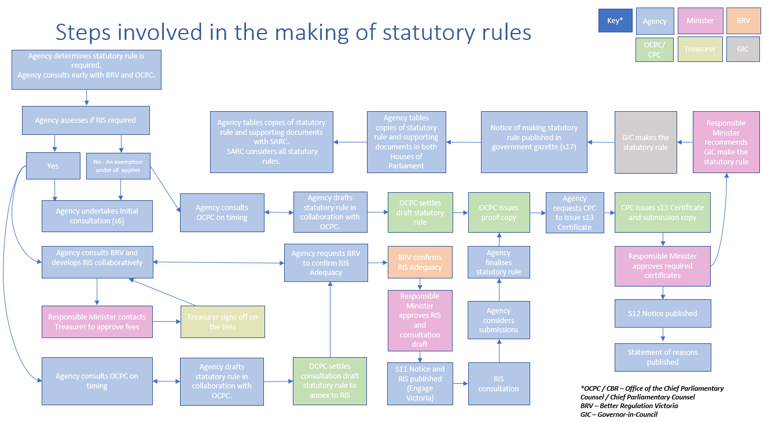
Making statutory rules.

Slide 10
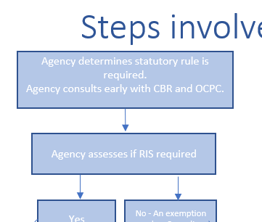
Starting point: Agency determines statutory rule is required and consults early with BRV and OCPC.
Agency assesses if a Regulatory Impact Statement (RIS) is required.
Making statutory rules.

Slide 11
Section 6 consultation
Where the SLA Guidelines require, the responsible Minister must ensure there is consultation as per below:
The responsible Minister may consult with any Head of a public sector body whose area of responsibility may be affected by the statutory rule either in addition to consultation with Ministers and the public, or instead of that consultation where the Minister determines that initial consultation with public sector body Heads is more appropriate.
The operation of a statutory rule or legislative instrument will not be affected where the responsible Minister determines it appropriate to consult with public sector body Heads only.
The responsible Minister must also issue a section 6 certificate.
Any other Minister whose area of responsibility may be affected by the proposed statutory rule, to avoid overlap and conflicting regulation.
Any sector of the public on which a significant economic or social burden may be imposed. Consider the need for (and scope of) the proposed statutory rule.
Making statutory rules.

Slide 12
RIS process
Agency develops RIS in collaboration with BRV
RISs can help make better policy
RISs are public consultation documents
BRV’s quarterly RIS training course
Engage early and regularly with BRV
RISs promote informed decision making
BRV provides support to agencies
Iterative drafting helps RIS meet adequacy criteria
Guidance material
Flexible approach to providing feedback
RIS must answer seven key questions
Letter of adequacy prior to release of RIS for public consultation
Making statutory rules.

Slide 13
Exemptions from the RIS process
Exemption certificates issued by the responsible Minister
Section 8 outlines the circumstances in which the responsible Minister may issue an exemption certificate for statutory rules.
Section | Exemption ground – The proposed statutory rule:
8(1)(a) | Would not impose a significant economic or social burden on a sector of the public.
8(1)(b) | Is a rule which relates only to a court or tribunal or the procedure, practice or costs of a court or tribunal.
8(1)(c) | Is of a fundamentally declaratory or machinery in nature.
8(1)(d) | Only increases fees in respect of a financial year by an amount not exceeding the annual rate approved by the Treasurer in relation to the State Budget for the purposes of section 8.
8(1)(da) | Only imposes a burden on a public sector body.
8(1)(e)(i) | Only prescribes under section 4(1)(a) an instrument or class of instrument to be a statutory rule.
8(1)(e)(ii) | Only exempts under section 4(1)(b) an instrument or class of instrument from the operation of the SLA.
8(1)(e)(iii) | Is an extension regulation.
Making statutory rules.

Slide 14
Exemptions from the RIS process
Exemption certificates issued by the responsible Minister
Section 8 continued…
Section | Exemption ground – The proposed statutory rule:
8(1)(e)(iv) | Only prescribes under s.4A(1)(a) an instrument or a class of instrument for the purposes of paragraph (h) of the definition of legislative instrument.
8(1)(e)(v) | Only prescribes under s.4A(1)(b) an instrument or a class of instrument to be, or not to be, a legislative instrument, or not to be, a legislative instrument or class of legislative instrument for the purposes of the SLA or any specified provision or provisions of the SLA.
8(1)(e)(vi) | Only exempts under s.4A(1)(c) an instrument or class of instrument from the operation of the SLA or any specified provision of the SLA.
8(1)(f) | Is required under a national uniform legislation scheme and an assessment of costs and benefits has been undertaken under that scheme.
8(1)(fa) | Is not of more than 12 months duration and is necessary to respond to (i) a public emergency, (ii) an urgent public health issue or an urgent public safety issue, or (iii) likely or actual significant damage to the environment, resource sustainability or the economy.
8(1)(g) | Deals with administration or procedures within or as between: (i) Departments or declared authorities within the meaning of the Public Administration Act 2004; or (ii) Departments within the meaning of the Parliamentary Administration Act 2005.
8(1)(h) | Notice of the proposed statutory rule would render the proposed statutory rule ineffective or would unfairly advantage or disadvantage any person likely to be affected by the proposed statutory rule.
Making statutory rules.

Slide 15
Exemptions from the RIS process
Exemption certificates issued by the responsible Minister
There are similarities between exemption grounds in section 8 SLA for statutory rules and section 12F SLA for legislative instruments, however they are not identical. Some exemption grounds under section 8 do not have equivalents under section 12F (i.e., exemptions under sections 8(1)(b) and 8(1)(e)). The exemptions bolded below are grounds for legislative instruments, but not statutory rules.
Section | Exemption ground – The proposed legislative instrument:
12F(1)(a) | Would not impose a significant economic or social burden on a sector of the public (like section 8(1)(a)).
12F(1)(b) | Is of a fundamentally declaratory or machinery nature (like section 8(1)(c)).
12F(1)(c) | Only increases fees in respect of a financial year by an amount not exceeding the annual rate approved by the Treasurer in relation to the State Budget for the purposes of section 8 (like section 8(1)(d)).
12F(1)(d) | Would only impose a burden on a public sector body (like section 8(1)(da)).
12F(1)(e) | Is an order made under the Administrative Arrangement Act 1983.
12F(1)(f) | Is required under a national uniform legislation scheme and an assessment of costs and benefits has been undertaken under than scheme (like section 8(1)(f)).
Making legislative instruments.

Slide 16
Exemptions from the RIS process
Exemption certificates issued by the responsible Minister
Section 12F continued….
Section | Exemption ground – The proposed legislative instrument:
12F(1)(g) | Is required to undergo, or has undergone, an analytical and consultation process which, in the opinion of the responsible Minister, is equivalent to the process for a RIS required under section 12E.
12F(1)(h) | Is not of more than 12 months duration and is necessary to respond to (i) a public emergency, (ii) an urgent public health issue or an urgent public safety issue, or (iii) likely or actual significant damage to the environment, resource sustainability or the economy (like section 8(1)(fa)).
12F(1)(i) | Deals with administration or procedures within or as between Parliamentary or Public sector departments (like section 8(1)(g)).
12F(1)(j) | Notice of the proposed legislative instrument would render the proposed legislative instrument ineffective or would unfairly advantage or disadvantage any person likely to be affected by the proposed legislative instrument (like section 8(1)(h)).
12F(1)(k) | Is made under a statutory rule and the regulatory impact statement for that statutory rule has adequately considered the impact of the proposed legislative instrument.
Making legislative instruments.

Slide 17
Exemptions from the RIS process
Exemption certificates issued by the Premier (section 9)
The Premier has the power to exempt a proposed statutory rule from the RIS process: s.9(1). However, this power may be exercised if there are special circumstances.
Requests for a Premier’s exemption certificate should be made in writing to the Premier, signed by the responsible Minister.
  Requests should be made at least 4 weeks before the proposed date of making the stat rule.
  A copy of the settled statutory rule must accompany the request.
The letter to the Premier must explain why, in the special circumstances of the case, the public interest requires the exemption. Draft letters should be sent to DPC’s OGC for consultation.
There is a strong presumption that a RIS should be prepared in all cases and the reasons why this presumption does not apply should be fully stated.
If a Premier’s exemption certificate is granted, agencies must:
  Table the certificate in both Houses of Parliament and send it to SARC;
  Forward SARC a copy of the reasons given to the Premier seeking the exemption.
Agencies are expected to commence and complete a RIS process, and have substantive regulations operating, during the lifetime of the certificate.
Please request OGC’s ‘Premier’s Exemption Certificate Departmental Checklist’ for more detail.
Making statutory rules.

Slide 18
Drafting the statutory rule
Agency drafts the statutory rules and provides to OCPC for settling
  The agency provides a Word version of the draft statutory rule to OCPC's Subordinate Legislation Manager by email with a request for settling.
  The drafter allocated to settle the statutory rule tests the draft against the powers to make the statutory rule in the authorising Act and against the other criteria in section 13 of the SLA.
  The drafter provides feedback, advice and, if necessary, redrafted provisions to the agency.
  The agency provides OCPC with a revised draft for further settling.
  When no further revisions are required by OCPC, the drafter will provide a settling letter to allow a RIS to be advertised or, if no RIS is required, for the statutory rule to be made.
  OCPC prepares a proof of the proposed statutory rule in the OCPC template and provides it to the agency.
  If the agency considers the proof to be in order, the agency requests a section 13 certificate and submission copies.
  OCPC then prepares the certificate and submission copies, which are required by the Governor in Council before the statutory rule can be made (under section 14 of the SLA).
Making statutory rules.

Slide 19
Comments and submissions
Notice and publication of the RIS (section 11)
Getting comments and submissions on the RIS
If a RIS has been prepared, the responsible Minister must ensure that a notice be published:
  in the Government Gazette,
  a daily newspaper circulating generally throughout Victoria, and
  if the responsible Minister considers it appropriate, in trade, professional or public interest publications as determined by the responsible Minister: section 11.
The notice must state the reasons for, and objectives of, the proposed statutory rule.
Agencies are also encouraged to give notice via the Engage Vic website.
Please check section 11(2) for the additional requirements of the notice.
The responsible Minister must consider all submissions and comments in relation to the draft statutory rule and RIS.

Slide 20
Making, publication and tabling
Making statutory rules
Once the statutory rule is settled, OCPC provides the agency with a section 13 certificate.
If a RIS was prepared a notice of the decision to make the proposed statutory rule must be published in the Government Gazette and a daily newspaper circulating generally throughout Victoria: section 12.
Section 14 of the SLA lists requirements for submission to the Governor in Council (GIC) and the documents which must accompany the proposed statutory rule.
The following documents must also accompany a statutory rule when it is submitted to the GIC:
  An Explanatory Memorandum (EM);
  A Recommendation page, signed by the responsible Minister; and
  An Agenda page signed by the responsible Minister and Departmental Secretary (or authorised delegate).
Making statutory rules.

Slide 21

Making, publication and tabling
Publication of statutory rules
After GIC makes the statutory rule, notice of the
statutory rule is published in the Government Gazette: section 17.
This usually occurs automatically as OCPC arranges the publication of the statutory rule itself after the Governor in Council makes it.
Publication of legislative instruments
The legislative instrument, if suitable to be published, must be published in the Government Gazette within 10 working days after the legislative instrument is made: section 16A.
Section 16(3) outlines circumstances in which a legislative instrument is not suitable for publication in full.
Making statutory rules.
Making legislative instruments.

Slide 22
Making, publication and tabling
Tabling statutory rules
Section 15 of the SLA requires statutory rules to be laid before Parliament within six (6) sitting days of the notice in the Government Gazette under s.17(2) that the statutory rule has been made. Where required, the following documents must accompany the statutory rule where they are required to be prepared:
  A certificate of consultation issued under section 6
  A Ministerial exemption certificate issued under section 8
  A Premier’s exemption certificate issued under section 9
  A compliance certificate in relation to RIS requirements and adequacy issued under s.10(4)
  A human rights certificate or human rights exemption certificate issued under s.12A
  An extension certificate and the Premier’s certificate agreeing to the extension issued under section 5A
  An infringements offence consultation certificate issued under section 6A
  A section 13 certificate issued by the Chief Parliamentary Counsel
  The responsible Minister’s recommendation that the GIC make the statutory rule.
In some cases, some of these certificates might not be required. Please check the SLA and the SLA Guidelines.
Making statutory rules.

Slide 23
Making, publication and tabling
Tabling legislative instruments
Legislative Instruments must be laid before each House of the Parliament on or before the 6th sitting day after it is made.
Copies of relevant certificates under Part 2A must also be tabled with the legislative instrument: see section 16B.
Section 16C requires the responsible Minister to ensure a copy of the legislative instrument and the relevant documents are given to SARC within 10 working days after the legislative instrument is made for the purposes of SARC exercising its scrutiny of subordinate legislation functions.
Making legislative instruments.

Slide 24
Making, publication and tabling
Documents which must be sent to SARC
Under the SLA, the following documents must be sent to SARC within 10 working days when a statutory rule or legislative instrument is made:
any applicable document required to be laid before Parliament (see previous slide);
if a Premier’s exemption certificate has been issued – the reasons given by the responsible Minister to the Premier as to why the public interest requires that the proposed statutory rule or legislative instrument be made without preparing a RIS; and
if a RIS has been prepared – the RIS and a copy of all comments and submissions received.
The following additional documents must also be sent to SARC:
a copy of BRV’s independent assessment of any RIS;
the explanatory memorandum;
copies of any notices published in the Government Gazette, newspapers or other publications advertising a RIS;
copies of any notices advising of the decision to make or not make a proposed statutory rule or legislative instrument;
in relation to legislative instruments, a copy of the legislative instrument (section 16C).
SARC will provide checklists of documents required by the Committee.
Making statutory rules.
Making legislative instruments.

Slide 25
Scrutiny of statutory rules
Scrutiny of statutory rules
Pursuant to section 21 of the SLA, SARC may report to Parliament if it considers that one of the criteria set out in this section has been breached. For example, if the statutory rule is prepared in contravention of the SLA or the SLA Guidelines or unduly trespasses on rights and freedoms.
A report to Parliament may contain any recommendations that SARC considers appropriate, including a recommendation that a statutory rule should be disallowed or amended.
Upon SARC’s recommendation, Parliament may disallow the statutory rule or legislative instrument in accordance with section 23.
Agencies should consult section 21 when considering the content of statutory rules to minimise the likelihood of disallowance.
Making statutory rules.

Slide 26
Scrutiny of legislative instruments
Scrutiny of legislative instruments
Part 5A of the SLA sets out the grounds for SARC to review a legislative instrument and recommend disallowance. This is similar to Part 5 of the SLA applying to statutory rules.
Making legislative instruments.

Slide 27

Extension of statutory rules
Where there are special circumstances that cause there to be insufficient time for a RIS to be prepared before a statutory rule sunsets, section 5A allows the responsible Minister, with the Premier’s agreement, to extend the statutory rule for up to 12 months.
During this time, a RIS must be completed if the statutory rule is to continue operation.
Process for extension
Agencies should:
  Consult OCPC and DPC as soon as they believe a
  statutory rule may require a Premier’s extension certificate;
  Contact DPC at least 10 weeks before a statutory rule expires for guidance on what information the request should include;
  Provide draft letters and draft certificates to DPC’s OGC for consultation.
The responsible Minister should request in writing that the Premier issue an extension certificate under section 5A(3). Such requests should be made
at least 4 weeks before the date by which the certificate is requested.
The extension is done by a set of extension regulations made by the Governor in Council, described in section 5A(4).
If granted, extension certificates must be laid before Parliament and sent to SARC (please refer to the SLA Guidelines for further information).
The Premier's certificate agreeing to the extension and the Minister's extension certificate (section 5A(1)) must accompany the proposed extension regulations when they are submitted to the Governor in Council for making (see section 14).
DPC’s OGC will provide the ‘Premier’s Extension Certificate Departmental Checklist.’

Slide 28
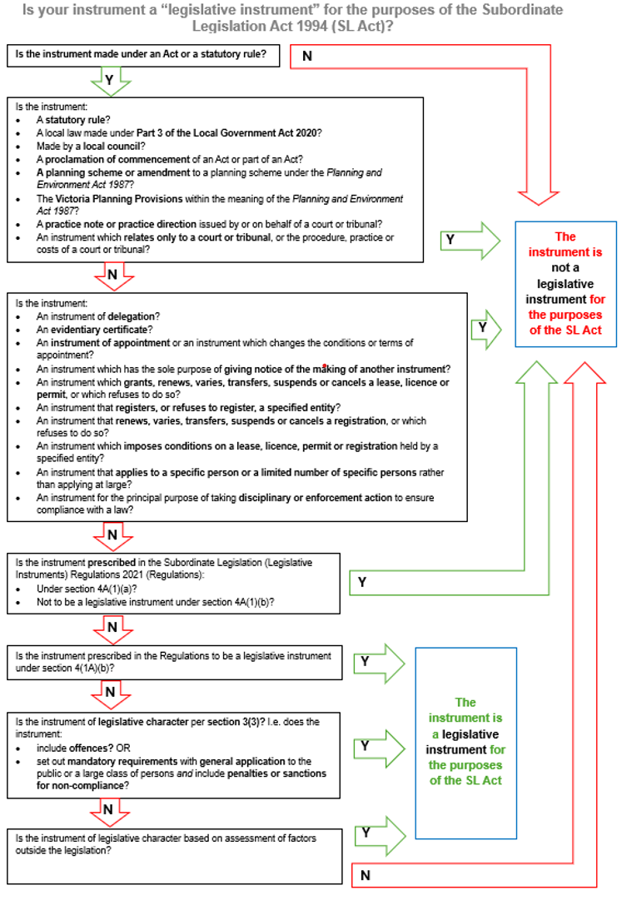
Legislative Instruments

Slide 29
Consolidation of legislative instruments
Amending legislative instruments
    Ensure all amending legislative instruments are included in the consolidated principal legislative instrument: section 16F.
The principal legislative instrument document would then be reproduced with those changes included.
The consolidation has to be published on the Internet and made available for inspection as soon as practicable after the amending legislative instrument is made.
Consider including a history of amendments.

Slide 30
Drafting tips
Drafting Tips
Language
  make the language consistent with authorising Act or legislation
  language must be concise, clear, modern and gender neutral
  active voice, present tense, singular
  “must” not “shall”
  “if” not “where” (except for location)
  avoid “hanging text”: use lead-in words and paragraphs and end provision at last paragraph.
Making legislative instruments.

Slide 31
Drafting tips
Drafting Tips
Structure
  Topic-specific Parts
  Useful headings
  Ensure logical sequence of provisions
  Short and direct provisions
  Single-idea provisions (especially if offences or penalties are involved)
  Create paragraphs for lists.
Making legislative instruments.

Slide 32
Suggested format for the layout of LIs
Drafting Tips
Title
Recital of instrument maker's title or position and authority to make the legislative instrument (LI)
Preliminary clauses:
  Purpose
  Commencement
  Definitions
  Revocation (or saving) of earlier instruments
Main clauses
Expiry or "sunset" clause (if any)
Schedule or schedules (if any)
Whether your LI needs any of the above will depend on the particular requirements of the LI and you should feel free to tailor the format accordingly
If LI is an Order in Council, use of the Executive Council templates is mandatory.

Slide 33
Key resources and guidance materials
Key resources and guidance materials include:
BRV’s Victorian Guide to Regulation, which explains the Government’s approach and requirements for regulatory impact analysis.
Toolkits that support the Victorian Guide to Regulation with more practical or detailed advice on the BRV website (available here).
DTF’s Cost Recovery Guidelines that provide a rigorous framework for use by government entities when considering, developing and reviewing user charges and regulatory fees.
OCPC’s Notes for Guidance on the Preparation of Statutory Rules (‘Guidance on Statutory Rules’).
SARC’s annual reports and alert digests.
SARC’s Resources for Legislation Officers.
Please note that DPC, OCPC and BRV’s websites may contain other additional resources, including other relevant training.

Slide 34
Thank you!

